Slide 1
Postsecondary and Workforce Readiness Act:
Key Provisions and Opportunities
Jonathan Furr
Executive Director
Education Systems Center at NIU
February 3, 2017
Notes:
Introduce presenters:
Ben Boer, Deputy Director, Advance Illinois
Jon Furr, Executive Director, Education Systems Center at Northern Illinois University
Dora Welker, Division Administrator, College and Career Readiness at ISBE
Advance Illinois and Education Systems Center staff the P-20 Council’s College and Career Readiness Committee, which led the various processes that led up to the Postsecondary and Workforce Readiness Act.
Our goal today is for you to gain a working understanding of the Act and its various components. But more importantly, we hope you’ll identify areas where your community can take a leadership role in the Act’ implementation.

Slide 2
PWR Act
  Public Act 99-0674 (HB 5729); signed by Governor on 7/29/16
  Four components:
    Postsecondary and Career Expectations (PaCE)
    Pilot of Competency-based High School Graduation Requirements
    Scaling of 12th Grade Transitional Courses
    College & Career Pathway Endorsements on High School Diplomas
Notes:
The Postsecondary and Workforce Readiness Act, which many people know by its bill number – HB 5729 – was signed into law by Governor Rauner in late July. As we’ll describe in the webinar today, there are four components of the bill:
Establishing a framework for Postsecondary and Career Expectations, or PaCE
Launching a pilot competency-based high school graduation requirements
Scaling 12th grade transitional courses, particularly in math, with the goal of significantly reducing postsecondary remediation rates, and finally
Establishing a system for college and career pathway endorsements on high school diplomas.

Slide 3
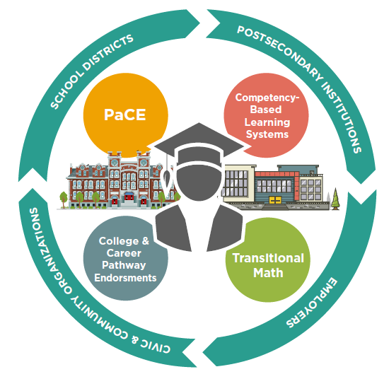
Notes:
While the Act has these four components, it is important to focus on the integration of these strategies. All four of the strategies within the PWR Act place learners at the center of efforts to support their preparation for college and career, and require coordinated and aligned community systems involving school districts, postsecondary education providers, employers, and other public and private organizations.
None of the strategies in the Act can be carried out by a school district, community college, or local employers working in isolation. Rather, they require alignment across these community systems.

Slide 4
PWR Act Background
P-20 Council PWR Steering Committee
- Met from 5/2012 to 7/2013
HB 3196
- Filed 2/15
HR 477
- Identified 5 aspects of PWR policy agenda where there was greater consensus for moving forward
- Adopted by House on 5/30/15
- 4 advisory committees with over 120 stakeholders each met 3 times; delivered recommendations on 2/1/16
- Developed college & career readiness framework and key success factors
- Resulted from over one year of meetings with agency leadership in context of PWR key success factors
- Joint committee of College & Career Readiness and Data, Assessment, and Accountability
PWR Act
Notes:
This Act didn’t emerge overnight. For the past four years, P-20 Council’s College & Career Readiness Committee has led a process to define policies to improve student transitions from high school to postsecondary education and careers. This process has included extensive stakeholder engagement, consultation with state agency leadership, and a hearing before legislative committees.
Initially, in 2012 and 2013, the P20 Council formed a Postsecondary and Workforce Readiness Committee as a joint committee of the College and Career Readiness and Data, Assessment, and Accountability Committees. This committee developed a multi-faceted college and career readiness framework and identified key success factors as a focus for improved college and career readiness, including individualized learning plans, improved alignment between high schools and community colleges, and career pathway systems.
Following this committee’s 2013 report, there was a year-long period where representatives of the College and Career Readiness Committee met with State agency leadership to translate these recommendations into legislation. That led to the filing of House Bill 3196 in the 2015 legislative session. While this bill didn’t become law, it started important conversations with different stakeholders and the General Assembly. The House Higher Education Committee convened a hearing to learn about leading strategies from across Illinois to improve the high school to college and career transition.
While HB 3196 was aggressive, it lead to discussion of certain areas where there was greater consensus. In May 2015, House Resolution 477 was adopted to establish advisory committees to issue recommendations in four areas where there was a need and stakeholder consensus to move forward. Each of these committees met three times from October 2015 through January 2016, involving over 120 members representing school districts, community colleges, universities, employers, state agencies, advocacy organizations, and other stakeholders. The recommendations that came from these committees were directly incorporated into HB 5729.
Hopefully this helps to demonstrate why such a significant bill could move forward in the current legislative environment with unanimous approval – there were years of engagement, discussion, and consensus building that led up to its passage.

Slide 5
Notes:
So let’s come back to our wheel diagram. I’m now going to turn it over to my colleague, Jon Furr, who will talk you through the various components of the Act.

Slide 6
Model Postsecondary and Career Expectations
By end of 12th grade
ISBE, ICCB, IBHE, ISAC
7/1/2017
By end of 11th grade
By end of 10th grade
By end of 9th grade
Activities to complete
Related knowledge students should possess
  Supported by school districts, parents, community
By end of 8th grade
Career Exploration and Development
College Exploration, Preparation, and Selection
Financial Aid and Literacy

Slide 7
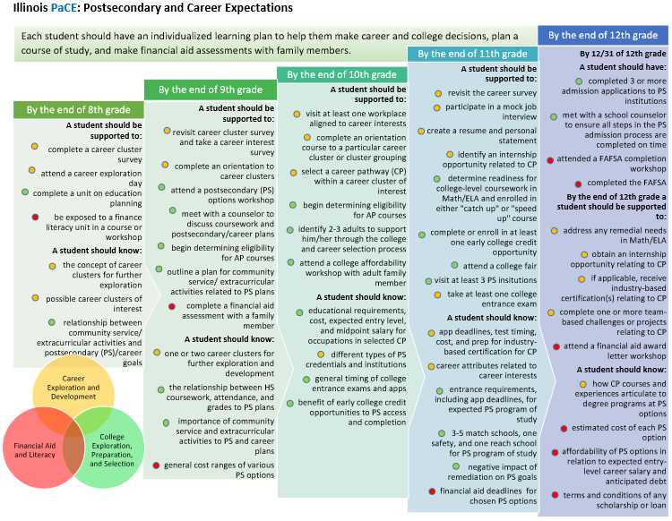
Notes:
The PaCE (Postsecondary and Career Expectations) framework provides guidance to parents, teachers, school administrators, community-based organizations, and students on what experiences students should have and what information students should know during their progression from middle grades through high school. The framework is organized around three key areas for student success (Career Exploration and Development; College Exploration, Preparation, and Selection; and Financial Aid and Literacy) and the principle that practical and financial preparation for college and career can and should be done together.
Coordinating framework for all school districts, community partners, and families to understand that they need to support students to “keep PaCE” and build out the systems that make that happen.

Slide 8
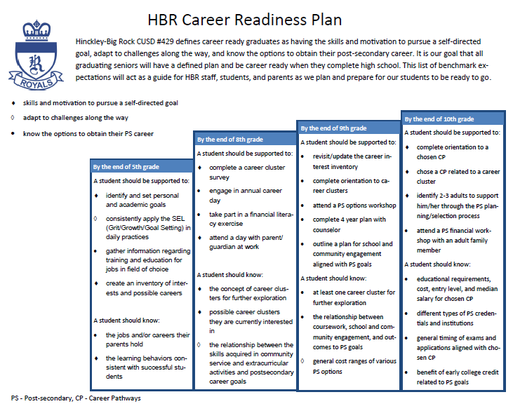
Opportunities for Leading Communities

Slide 10
Why?
Recognize and incentivize student attainment of knowledge and demonstrations of skills important for both success in both postsecondary and employment
Encourage career exploration and development to improve decision-making
Promote greater consistency of college and career pathway program structures
Institutionalize college and career pathways as a key strategy for postsecondary and career success

Slide 11
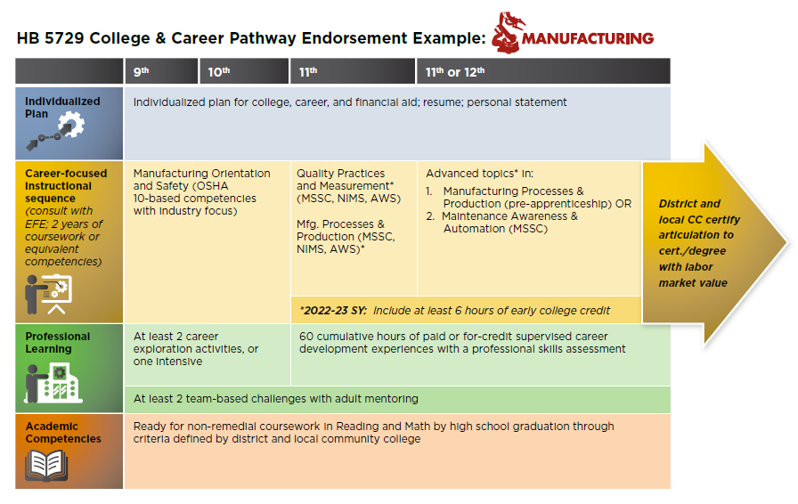

Slide 13
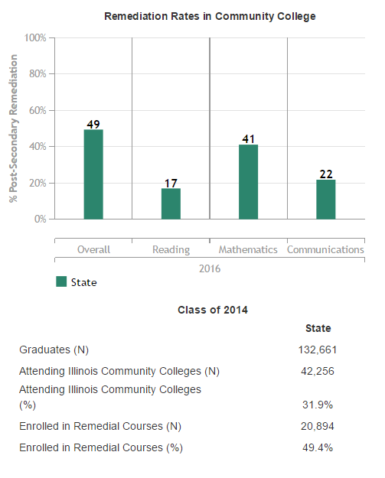
Why?
Notes:
Transitional math courses are courses delivered to students during the senior year of high school which, if successfully completed as determined based on an overall course grade, result in transcripted credit that can guarantee student placement into either an IAI transfer-level math course or a credit-bearing math course required for career and technical postsecondary education programs.
Transitional math courses are typically delivered by high school faculty with community college collaboration defined through a local partnership agreement. While transitional math competencies may be delivered through a stand-alone course, integrated models are encouraged.

Slide 14
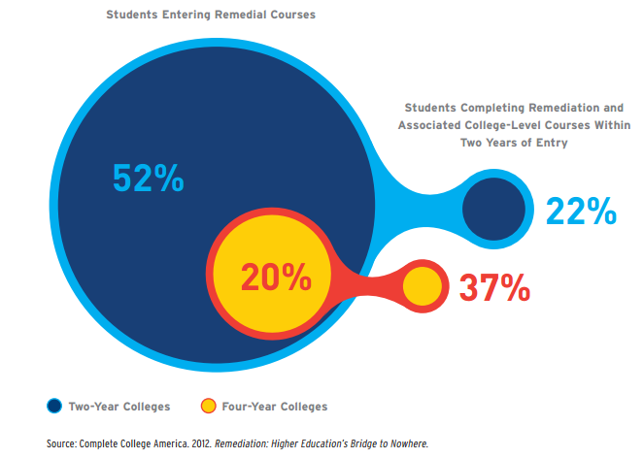
Why?
Notes:
Transitional math courses are courses delivered to students during the senior year of high school which, if successfully completed as determined based on an overall course grade, result in transcripted credit that can guarantee student placement into either an IAI transfer-level math course or a credit-bearing math course required for career and technical postsecondary education programs.
Transitional math courses are typically delivered by high school faculty with community college collaboration defined through a local partnership agreement. While transitional math competencies may be delivered through a stand-alone course, integrated models are encouraged.

Slide 15
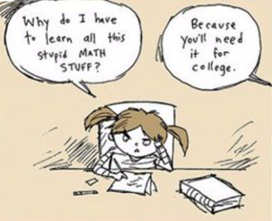
Why?
Notes:
Transitional math courses are courses delivered to students during the senior year of high school which, if successfully completed as determined based on an overall course grade, result in transcripted credit that can guarantee student placement into either an IAI transfer-level math course or a credit-bearing math course required for career and technical postsecondary education programs.
Transitional math courses are typically delivered by high school faculty with community college collaboration defined through a local partnership agreement. While transitional math competencies may be delivered through a stand-alone course, integrated models are encouraged.

Slide 16
Postsecondary Math Pathways
STEM
Career goals that require application of calculus or advanced algebraic skills
Technical
Career goals in technical fields that do not require application of calc, advanced algebraic, or advanced stats skills
Quantitative Literacy/ Stats
Career goals outside of STEM or Technical – focus on general stats, data analysis, quant. literacy, problem solving

Slide 17
Transitional Math: A Student’s Perspective
11th Grade Projected Readiness Determination:
Use statewide criteria
Based on each student’s postsecondary math pathway
Not Projected Ready:
Transitional math co-developed by school district and community college
Projected Ready:
Student decides whether to take math in 12th grade
Successful Completion of Transitional Math:
Placed in college-level math course in applicable math pathway
Unsuccessful Completion or No Math Senior Year:
Subject to general placement processes
Successful Completion of Rigorous Math in 12th Grade:
Placed in college-level math course in applicable math pathway

Slide 19
Why?
Provide students and families with a clearer understanding of the knowledge and behavior required for college and career readiness
Give students greater agency to become active participants in their learning, including in more relevant contexts
This is a big shift -- build out a variety of models, local champions, and state-level supports that promote scaling beyond the pilot

Slide 20
Flexibility for Local Innovation
A participating school district can decide:
  Which years?
  Which graduation requirements?
  Which high schools?
Core strategy supporting the community’s efforts to better prepare students for college, career, and life
Notes:
5 core common criteria:
Students must demonstrate mastery of all required competencies to earn credit.
Students advance once they have demonstrated mastery, and students receive more time and personalized instruction to demonstrate mastery if needed.
Students have the ability to attain advanced college and career-related competencies beyond those needed for graduation. There is no “ceiling” for competency attainment while in high school.
Students are assessed using multiple measures to determine mastery, usually requiring application of knowledge.
Students can earn credit toward graduation in ways other than seat time, including learning opportunities outside the traditional classroom setting.
Districts replacing core academic graduation requirements (language arts, math, or science) with a competency-based system must demonstrate how competencies can be demonstrated in Career and Technical Education (CTE) courses and professional learning experiences. Integrated courses including equal focus on academic and CTE components are encouraged.
All plans must incorporate “adaptive competencies” defined by the school district. Adaptive competencies are foundational skills needed for success in college, careers, and life such as, but not limited to, work ethic, professionalism, communication, collaboration and interpersonal skills, and problem-solving.
Postsecondary partners: No “ceiling” for competency attainment; ensure student outcomes can be translated for admission and financial aid.

Slide 21
Partnerships and Engagement
Partnership with a community college and a 4-year institution
    Plan must address how graduates from the system will provide information normally expected by postsecondary institutions for admission and financial aid
Plan for engaging feeder K-8 schools
Teachers:
    Initial demonstration of commitment by teachers involved with pilot, demonstrating engagement throughout the application development process
    Statement by union president on union’s position
    Standing planning and implementation committee
Notes:
5 core common criteria:
Students must demonstrate mastery of all required competencies to earn credit.
Students advance once they have demonstrated mastery, and students receive more time and personalized instruction to demonstrate mastery if needed.
Students have the ability to attain advanced college and career-related competencies beyond those needed for graduation. There is no “ceiling” for competency attainment while in high school.
Students are assessed using multiple measures to determine mastery, usually requiring application of knowledge.
Students can earn credit toward graduation in ways other than seat time, including learning opportunities outside the traditional classroom setting.
Districts replacing core academic graduation requirements (language arts, math, or science) with a competency-based system must demonstrate how competencies can be demonstrated in Career and Technical Education (CTE) courses and professional learning experiences. Integrated courses including equal focus on academic and CTE components are encouraged.
All plans must incorporate “adaptive competencies” defined by the school district. Adaptive competencies are foundational skills needed for success in college, careers, and life such as, but not limited to, work ethic, professionalism, communication, collaboration and interpersonal skills, and problem-solving.
Postsecondary partners: No “ceiling” for competency attainment; ensure student outcomes can be translated for admission and financial aid.

Slide 22
Waivers
Participating school districts can obtain State Supt. waiver or modification of any School Code provisions/rules to support the proposed competency-based system
However, no waivers for: State assessments, accountability, teacher tenure/seniority, evaluations, or protections for particular groups of students (SWD, ELL)
Any waiver of teacher educator licensure requirements must ensure that an appropriately licensed teacher and the provider of instruction jointly determine the method for assessing competency of mastery and jointly verify whether a student has demonstrated mastery
Notes:
5 core common criteria:
Students must demonstrate mastery of all required competencies to earn credit.
Students advance once they have demonstrated mastery, and students receive more time and personalized instruction to demonstrate mastery if needed.
Students have the ability to attain advanced college and career-related competencies beyond those needed for graduation. There is no “ceiling” for competency attainment while in high school.
Students are assessed using multiple measures to determine mastery, usually requiring application of knowledge.
Students can earn credit toward graduation in ways other than seat time, including learning opportunities outside the traditional classroom setting.
Districts replacing core academic graduation requirements (language arts, math, or science) with a competency-based system must demonstrate how competencies can be demonstrated in Career and Technical Education (CTE) courses and professional learning experiences. Integrated courses including equal focus on academic and CTE components are encouraged.
All plans must incorporate “adaptive competencies” defined by the school district. Adaptive competencies are foundational skills needed for success in college, careers, and life such as, but not limited to, work ethic, professionalism, communication, collaboration and interpersonal skills, and problem-solving.
Postsecondary partners: No “ceiling” for competency attainment; ensure student outcomes can be translated for admission and financial aid.

Slide 23
Implementation Timeline
State Supt publishes initial application
DUE 1/27/17
School districts selected for initial pilot commence planning or implementation
School districts commence or continue implementation
State Supt can establish a new cohort
19-20 SY
18-19 SY
17-18 SY
16-17 SY

Slide 24
Jon Furr
jfurr@niu.edu
www.pwract.org

