Slide 1

Creating a Community Vision and Commitment for College and Career Readiness
College and Career Readiness Innovations Summit
Sauk Valley Community College
February 3, 2017

Slide 2
Our Vision: Regional Collaboration to Raise Educational Attainment
The Illinois P-20 Council’s goal is to increase the proportion of adults in Illinois with high-quality degrees and credentials to 60% by the year 2025.
The Northern Illinois Regional P-20 Network collaborates to increase college and career success for our students through regional action toward the 60 x 2025 goal.

Slide 3
Degrees and Credentials as an Equity Issue
America’s Divided Recovery: College Haves and Have Nots
  No recovery for workers with high school diplomas
  99% of 11.6 million new jobs went to workers with postsecondary degrees

Slide 4
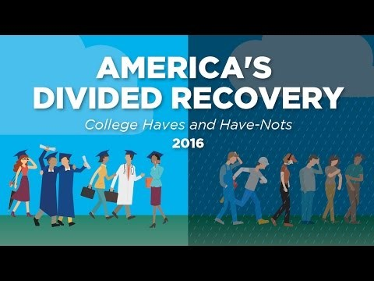

Slide 5
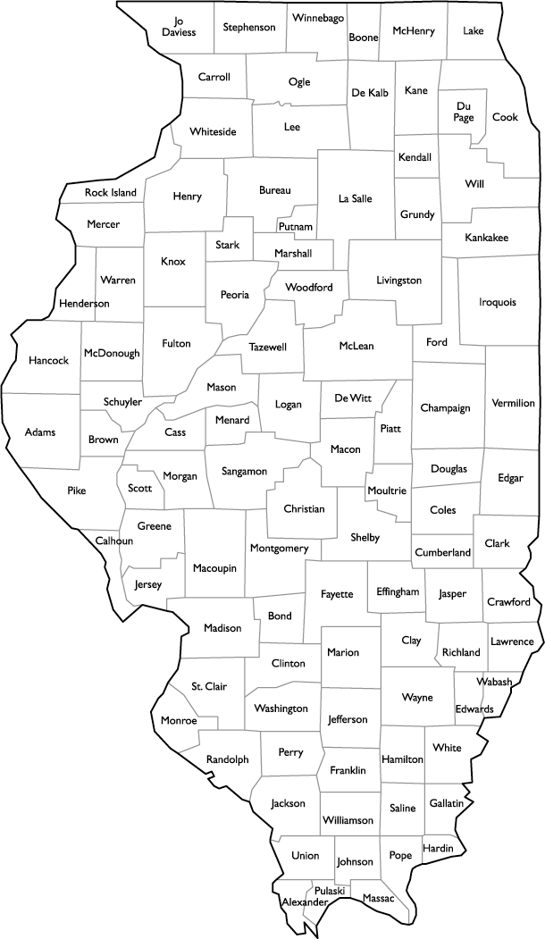
Stephenson 30.1%
Winnebago 31.6%
JoDaviess 33.5%
Ogle 32.8%
Carroll 26.7%
DeKalb 43.1%
Whiteside 30.0%
Lee 28.6%
Highest
DuPage 57.2%
Bureau 28.7%
Percent of Illinois Citizens with at least an Associates Degree
State Average 43.6%
Lowest
Alexander 15.7%

Slide 6
Our P-20 Network Commitment:
Shared Problems and Shared Solutions
Problems our educational system is facing
    Different expectations for students
    Lack of consistency across institutions
    Low completion of post-secondary programs
    Shortage of skilled workers
Solutions our P20 Network is implementing
    Vertical collaboration and communication
    System-level tools and activities
    Community-based action

Slide 7
45 Participating Institutions
Community Colleges | School Districts
College of DuPage | Naperville 203, DuPage ROE
College of Lake County
Elgin Community College | Elgin U-46
Harper College | Arlington Heights HS 214, Barrington HS 220, Palatine HS 211
Highland Community College | Freeport 145, ROE 8
Illinois Valley Community College | Seneca Township HS 160
Kishwaukee College | DeKalb 428, Rochelle HS 212, Sycamore 427
McHenry County College | Huntley 158
Rock Valley College | Rockford 205
Sauk Valley Community College | River Bend 2, Rock Falls 301, Sterling 5
Waubonsee Community College | Hinckley-Big Rock 429 Kaneland 302, West Aurora 129
Education Agencies and Organizations
  IL Board of Higher Education
  IL Community College Board
  IL State Board of Education
  IL Student Assistance Commission
  IL P-20 Council
  IL Dept. of Employment Services
  IL Dept. of Commerce & Economic Opportunity
  IL Workforce Investment Board
  IL Office of the Governor
  Northern Illinois University
  University Center of Lake County
  Advance Illinois
  IL Action for Children
  IL Business Roundtable
  Voices for Illinois Children

Slide 8
Building a P-20 System
Goal to increase educational attainment and student career success through collaborative action to 60x25
  Convene and facilitate system-level activities to address P-20 issues comprehensively
  Conduct research and evaluations
  Develop data infrastructure and reports
  Create and pilot action models
  Communicate throughout the system
  Mobilize funding and connections to resources

Slide 9
Benefits of a Regional Network
  System-level approaches across all levels
  Convening and facilitating
  Sharing best practices and inspiration for change
  Increased involvement in state policy development
  Professional think tanks
  Training
  Research: 20 surveys, 5 policy papers, 6 lit reviews, 25 research reports, more in process
  Resources
We are not interested in just having great conversations. What are we doing to change the system?

Slide 10
Challenges
  Need for long-term, dedicated support from a backbone organization
  Delivering results on time
  Sustaining involvement
  Geography
  Diversity of member institutions
  Change fatigue
  Coordination with local and state-level activity and avoiding duplicating or complicating other efforts
  Disruptive information and innovations
  Resources

Slide 11
Northern Illinois Regional P-20 CEOs
Monitor and Direct Five Work Groups and Action Teams in All Sectors
Birth-3rd Grade
Workforce Development
Alignment of Standards
Articulation & Adult Learners
Student Support Services

Slide 12
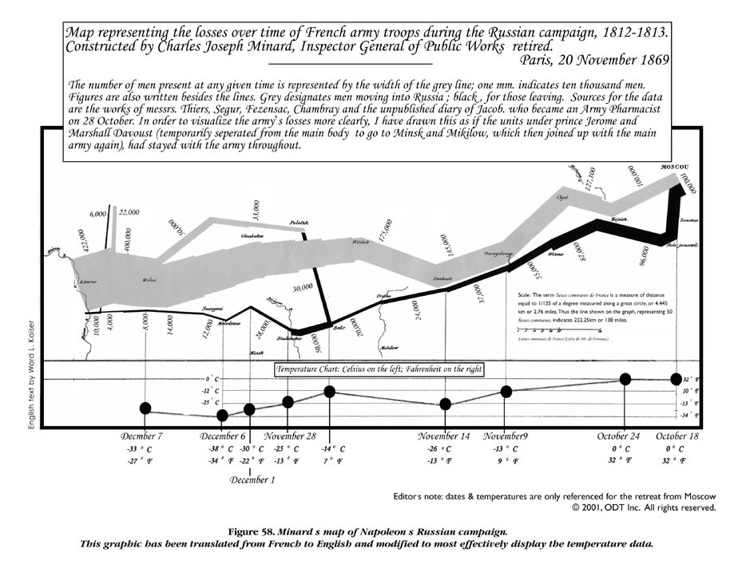
Does our current educational system function like Napoleon’s Campaign in Russia?

Slide 13
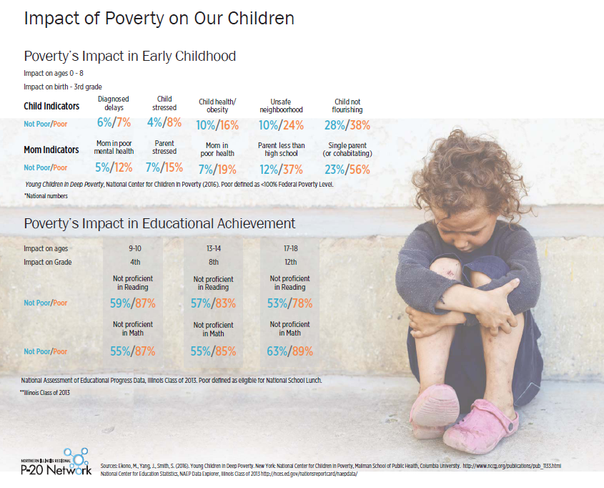

Slide 14
Regional P-20 Network Focus:
Early Childhood, Where Success Starts
Shared Problems from Birth-3rd Grade
  Almost 90% of children in poverty will not be ready for college coursework.
  The Early Catastrophe: between low-income and high-income children, we find a 30-Million Word Gap by age 3.
  School to Prison Pipeline: Students reading below grade level in 3rd grade are 6x more likely to drop out; high school drop outs are 63x more likely to be incarcerated.
  Almost 100 organizations receive local, state, national, and private funds to implement B-3 programs.

Slide 15
Illinois EC Infrastructure is Complex.
IL State Board of Education
IL Dept of Human Services
IL Dept of Public Health
IL Dept of Child and Family Services
Child and Family Connections
(25)
Regional Offices of Education
(35 + 3 ISCs)
CCR&Rs
(16)
DHS Regions (5)
IDPH Regions
(7)
DCFS Regions
(3)
Local School Districts:
Early Childhood (0-3, 3-5)
K-12
Local Programs:
Child care
Child Care Assistance Program
Local Programs:
Developmental professionals and services
Local Offices & Programs:
Family Case Managemt
Medical Assistance
SNAP
TANF
WIC
Various DHS- funded services
Health Depts and Local Programs:
Children with Spec Health Care Needs
Family Planning
Genetics/Newborn Metabolic Screening
Immunizations
Lead Program
Newborn Hearing Screening
Subsequent Pregnancy Project
Local Programs:
Child care licensing
Child Protective Services
Early Childhood Project
Office of School Readiness
Local community collaborations work across sectors
Child and Family Outcomes
Governor’s Office of Early Childhood Development (OECD), 2016.

Slide 16
Birth to Five Programs and Funding Streams are Complex.
US Department of Education
US Department of Health and Human Services
Head Start/
Early Head Start
IL Department of Human Services
IL Department of Public Health
IL Healthcare and Family Services
IL Department of Child and Family Services
IL State Board of Education
Child Care Assistance Program
Early Intervention
Better Birth Outcomes
Family Case Management
Healthy Families
Parents Too Soon
High Risk Infant Follow Up
MIECHV Program
Migrant and Seasonal Head Start
Perinatal Depression
RTT-ELC
Refugee and Immigrant Services
SNAP
TANF
Teen Parent Services
WIC (USDA funded)
Children with Special Health Care Needs
Family Planning/ Title X Family Planning
Genetics/Newborn Metabolic Screening
Immunizations
Lead Program
Newborn Hearing Screening
Subsequent Pregnancy Project
All Kids
Medicaid
Moms and Babies
Child Protective Services
Early Childhood Project
Licensing
Office of School Readiness
Early Childhood Block Grant (Preschool for All & Prevention Initiative)
Preschool Development Grant
Title I
CACFP/School lunch (USDA)
Schools and Community-Based Programs
LEGEND
Federal Funds
State Funds
Blended Funds
This slide was adapted by OECD from materials developed by consultants Jeanna Capito and Karen Yarbrough.
Children and Families

Slide 17
Early Childhood: Shared Solutions
Birth-3rd Grade Supports and Resources
  2-1-1 Access to Social Service Resources in all counties
  Early Childhood Absenteeism Initiative across the state
  Community Systems Development with DeKalb County
  BLOCK Fest® to develop early math and science skills

Slide 18
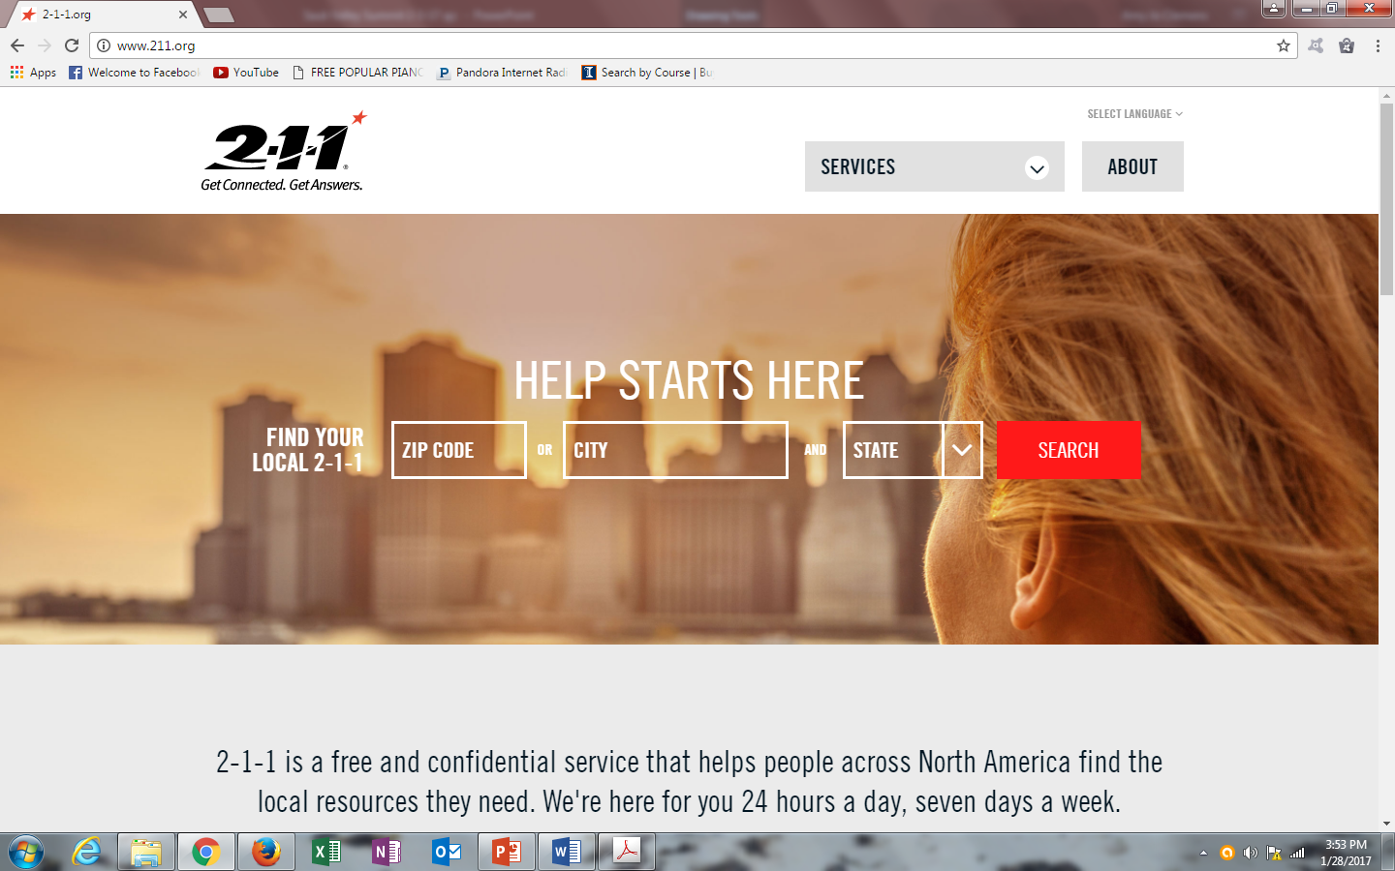

Slide 19

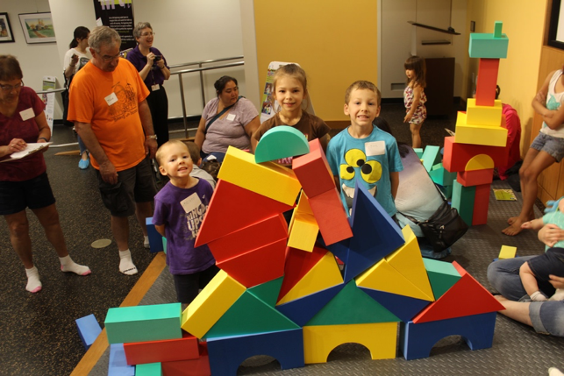
Coming to SVCC on February 18th

Slide 20
Regional P-20 Network Focus:
3rd to 12th Grade, Where Success Grows
Shared problems from 3rd Grade-12th Grade
  Only 35% of our 3rd graders are reading on grade level.
  Only 28% of our 8th graders have passed Algebra I.
  Only 86% of our seniors are graduating.
  49% of the new graduates enrolling in community college need remedial classes.
  Nationally, fewer than 15% of the students placed in developmental classes earn degrees.
Deep inequities exist within our system.

Slide 21
Shared Solution: Career Pathways
  Model Career Pathway Documents
    Career-oriented information and inspiration
    College-bound academic expectations for all
    Highlight emerging and in-demand careers
    Emphasis on work-based learning
    Highlight local employers and local economic development priorities

Slide 23
Shared Solution: Reduce Remediation
Alternatives to Developmental Ed Courses
  Transitional Math Courses for HS seniors who are NOT ready for college course work
  Placement decisions based on more than one assessment
  Co-requisite classes taught during the same semester as credit-bearing courses at post-secondary level
  Increased articulation between high school staff and higher education faculty

Slide 24
Shared Solution: Early College Options
  Graduating from high school with at least
  9 postsecondary credits
    Ensure all high schools have dual credit, Advanced Placement, or International Baccalaureate options.
    Assist high school teachers in becoming qualified to teach dual credit
    Promote early college programs in high school to improve preparation for post-secondary and save money for families
      dual enrollment
      dual degrees
      general education certificates

Slide 25
Early College Options
Dual Credit
Dual Enrollment
Industry Credential
Gen Ed Certificate
Dual Degree

Slide 26
Shared Solution: Community Involvement
  Support communities that emphasize college and career readiness from 3rd-12th grade
    FAFSA Completion/College Going Crosswalk
    Author On PaCE to Thrive - Community Guide to Building a College and Career Readiness Culture
    Launch Pilot Parent University – Hispanic Families

Slide 27
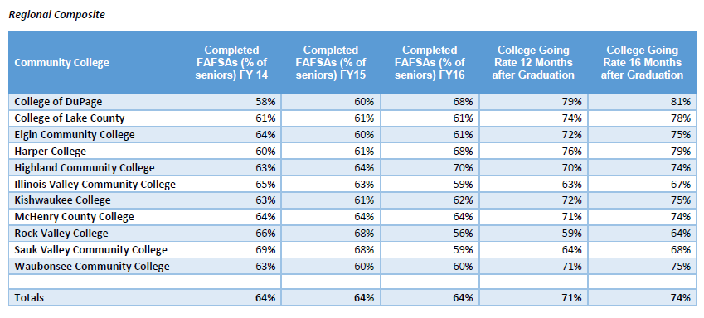
FAFSA and College Enrollment Data
http://www.niu.edu/p20network/_pdfs/9.8.2016-meeting-materials/FAFSA-Crosswalk-with-College-Going-Rates-8.12.2016.pdf

Slide 28
Guide for Creating
College and Career Readiness throughout the Community
http://www.niu.edu/p20network/_pdfs/Community-Guide-Cultivating-Community-Focus-on-CCR.pdf

Slide 29
Northern Illinois Regional P-20 Network announces

Slide 30
Regional P-20 Network Focus:
Adult Learners, Where Success Continues
Shared Problems for Adult Learners
  1.6 million adult residents in northern Illinois have earned some college credit but not a bachelor’s degree.
  Different higher ed policies and practices are needed to support returning adult learners.
  Prior Learning Assessment is inconsistent across the region.
    Credit for documented academic learning through assessment
    Credit for employer- required certifications (Military, Industry Credentials)

Slide 31
Shared Solutions: Policies/Practices to Support Adult Learners
Tailor programs to the special needs of adult learners
  Student services offered evenings and weekends
  Courses offered with flexible times and locations
  Nimble course schedules with accelerated course options
  Online and other distance learning opportunities
  Child care available
  Financial aid for part-time learners

Slide 32
Shared Solutions: Credit for Prior Learning
Students awarded credit for documented prior learning
  Are more likely to graduate
  Enroll in more courses
  Earn higher grades
  Complete degrees 2.5 times more often than traditional students
  Minority degree completion 8 times higher than traditional minority students

Slide 33
Solutions our P-20 Network is implementing
    Vertical collaboration and communication
    System-level tools and activities
    Community-based action

Slide 34
Response
“Every meeting I go to is full of bad news. What we are doing here is really positive. What a relief!”
  High school superintendent CEOs meeting, Regional P-20 Network
“The collaborative approach you are using is absolutely right. I feel very hopeful about your work.”
  Tony Smith, Illinois State Superintendent CEOs meeting, Regional P-20 Network

Slide 35
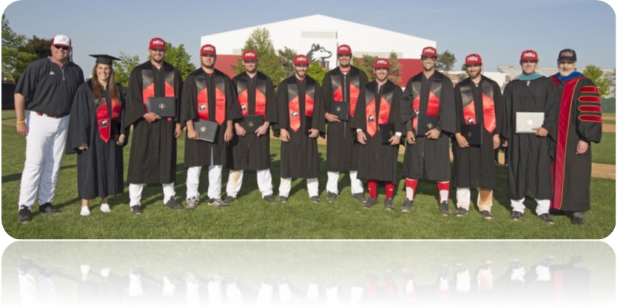
Questions ?
Doug Baker
President
Northern Illinois University
ddbaker@niu.edu
Amy Jo Clemens
NIU P-20 Center
ajclemens@niu.edu

