Slide 1
PaCE-ing ourselves
Hinckley-Big Rock CUSD #429
College and Career Readiness Innovations Summit
February 2, 2018
@HBR429Sup

Slide 2


Slide 3
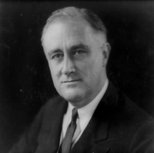
“Do something. If it works, do more of it. If it doesn't, do something else.”
“One thing is sure. We have to do something. We have to do the best we know how at the moment... If it doesn't turn out right, we can modify it as we go along.”
Notes:
FDR quotes

Slide 4

https://www.hbr429.org/domain/624
Notes:
Share our story

Slide 5

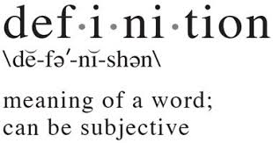



Career Readiness
Career ready graduates have the
skills and motivation to pursue a self-directed goal,
adapt to challenges along the way,
and know the options to obtain their post-secondary career.
Notes:
It all started with a Board directed goal and a definition….three year goal with work still being done today to refine and improve

Slide 6


Hinckley-Big Rock CUSD #429
Community Engagement

Slide 7



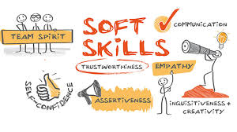
Hinckley-Big Rock CUSD #429
Community Engagement
Notes:
Work with Hinckley Business Association...survey on soft and hard skills...build partnerships
Regular part of our communication, both internal and external

Slide 8
Hinckley-Big Rock CUSD #429
Survey question examples
How many jobs have you filled in the last 12 months?
How many jobs do you expect to fill within the next 12 months?
Which soft skill rises to the top of the list when considering entry-level success in your workplace?
Which hard skill rises to the top of the list when considering entry-level success in your workplace?
Which of the hard skills from your list can be developed for new employees after you hire the employee in your workplace?
Which are more important for your success in your workplace, hark skills or soft skills? Why?
Notes:
20% response rate….n=6

Slide 9

https://www.isbe.net/Documents/PaCE_Revisions.pdf
Notes:
How we PaCEd ourselves

Slide 10



PaCE-ing ourselves
Our use of the document
Notes:
Aligned with our definition - Skill and motivation to pursue a self-directed goal, adapt to challenges, and know the options for their post-secondary career
Used as a guideline
Identify what we are already doing and what we want to incorporate

Slide 11



PaCE-ing ourselves
Our use of the document
Notes:
Brainstorm on what is possible
Develop a plan
Communicate and share the plan

Slide 12
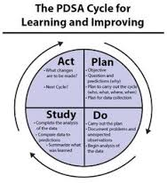

PaCE-ing ourselves
Our use of the document
Notes:
Implement the plan
PDSA Framework

Slide 13
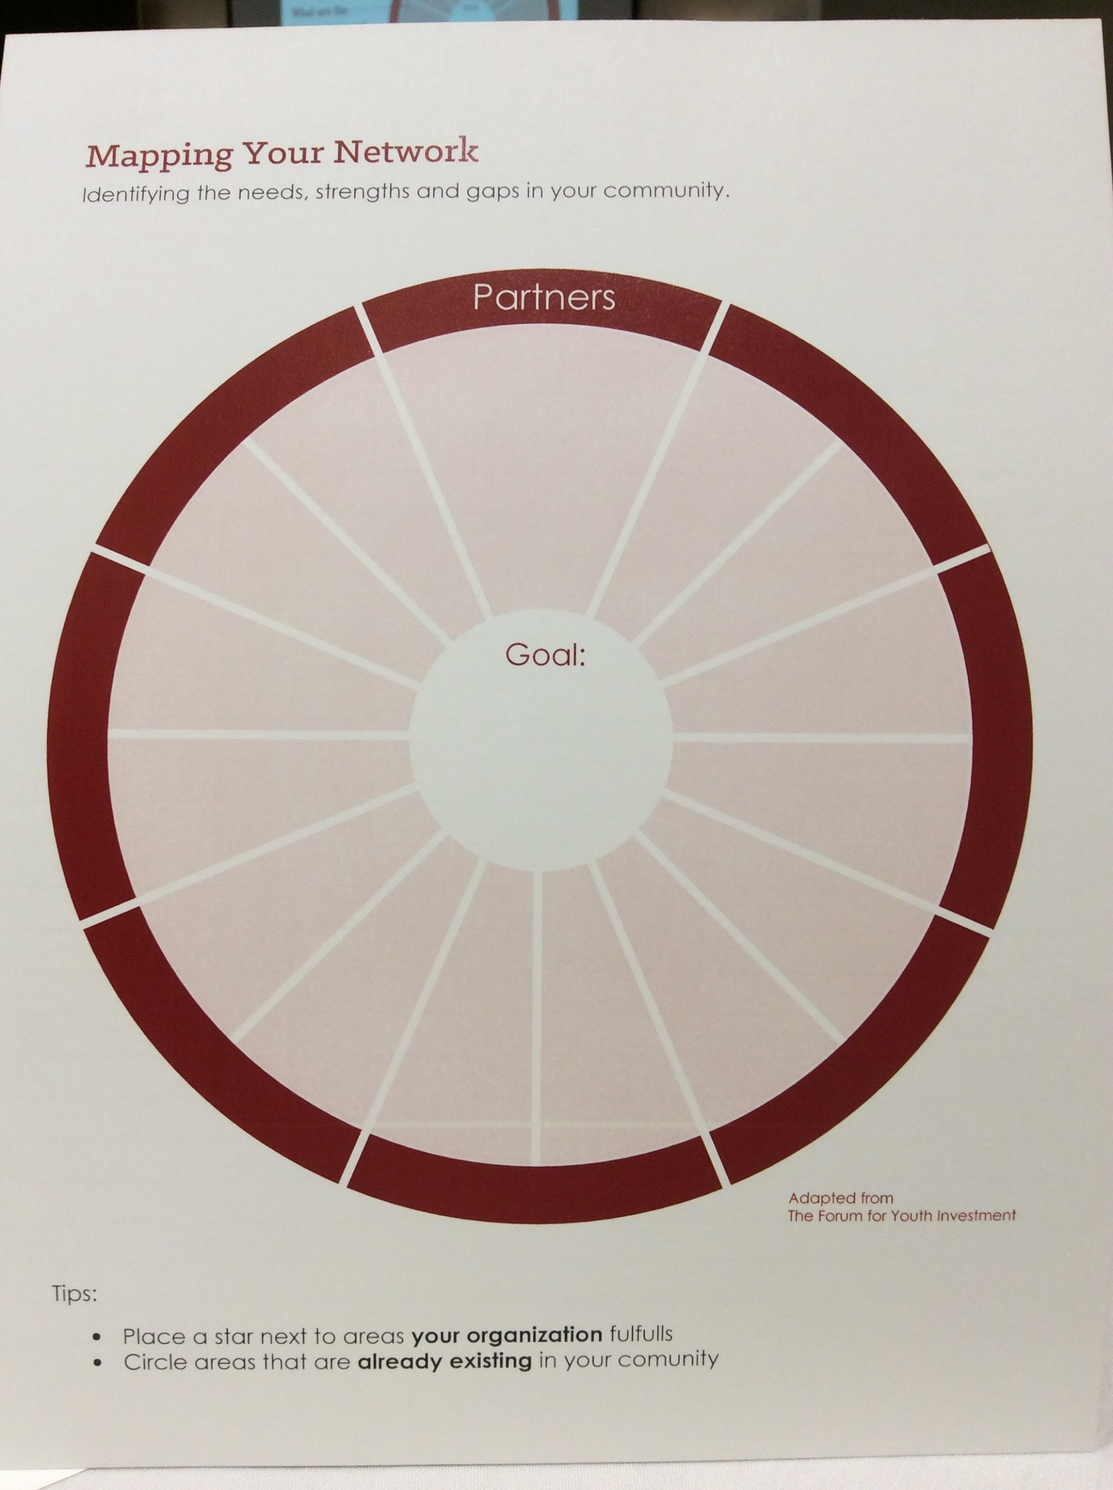


PaCE-ing ourselves
Notes:
Travis -
As a result of our review of our community engagement, we made some changes to our community engagement.
1- FAFSA Completion - College Changes Everything Month in October to align with the new FAFSA Completion timeline….Reached out to the Hinckley Public Library...willingness to host an off-site meeting for FAFSA information and/or completion.
2 - Goals of local villages - reached out to each Village Presidents and are setting up meetings to discuss the goals of our two communities….

Slide 14



District Wide PaCE-ing
Notes:
Highlight careers at HBRES
HBRMS
Career day
Job shadow mom or dad is encouraged

Slide 15


District Wide PaCE-ing
Notes:
Career Cruising full suite at HBRMS and HBRHS
Parent/Community communication….linked

Slide 16



District Wide PaCE-ing
Notes:
HBRHS
Course Catolog…. Programs of Study by career cluster...starts on page 11
Senior Thematic Studies….found on page 31 of course catalog
Writing SIP goal….linked

Slide 17
2016 Results
89% have goals related to their future career ambitions
97% have goals for next year
89% revealed they adapt to challenges in order to succeed
92% ar ready for the next step in their educational career
Notes:
Spring of 2014, 2015, and 2016 administered transitional surveys

Slide 18
Class of 2018
97% have a personal goal for the future
98% know the options to attain their goal
Notes:
Get alumni contact information and ask them two simple questions

Slide 19

Hinckley-Big Rock CUSD #429
HBR Career Readiness Plan

Slide 20
Contact Information
Dr. Travis McGuire
(815) 286-7578
tmcguire@hbr429.org
@HBR429Sup

