Slide 1
Embedding Soft Skills into Content Instruction

Slide 2
Explain the CEO Program
Describe what I’ve learned from business
Reflect/connect education and business
Goals

Slide 3
HELLO!
LeAndra Hartman
Family and Consumer Science Retiree
Retail Store Drop-Out
Creating Entrepreneurial Opportunities Facilitator
Sauk Valley Leadership Program Facilitator

Slide 4
Creating Entrepreneurial Opportunities
Juniors and seniors apply and selected
Whiteside Area Career Center
Drive to location
90 minutes every day, 2 credit class
Facilitator, not a teacher
1st semester class business
2nd semester each student starts a business to be showcased at a tradeshow in May
Investors support the program

Slide 5
IFH Visit
45-50 Business Visits

Slide 6
Small Business Development Center
60+ Speakers

Slide 7
Each student Selects a business mentor
Mentor Match

Slide 8
Fiesta
Parade
Giving Back

Slide 9
Class Business 2017
Dinner and Trivia Night

Slide 10
Individual Businesses Showcased
May Trade Show

Slide 11
What have I learned?

Slide 12
CEO has made me think differently.
In Business:
It’s okay to fail.
In CEO/School?

Slide 13
CEO has made me think differently.
In Business:
Collaboration, group problem-solving = surround yourself with people smarter than yourself, people who think differently
In CEO/School?

Slide 14
Teaching
https://www.youtube.com/watch?v=_Tf_smu76T0&index=1&list=RD_Tf_smu76T0

Slide 15
CEO has made me think differently.
In Business:
Good communication skills
In CEO/School?

Slide 16
Typical Class Day

Slide 17
CEO has made me think differently.
In Business:
Leaders with Mission Statements and Vision
In School? As a teacher?

Slide 18
CEO has made me think differently.
In Business:
Creating Culture
In CEO/School?

Slide 19
CEO has made me think differently.
What are you/we doing now?
A LOT!
Intentional

Slide 20
“This class helps to unlock potential that is not otherwise expressed in a traditional classroom. There is always educational reform in history and the current education system has been in place longer than any other, and this class is helping to move it forward and make it better. It takes a high school student and shows them 'this is what life actually is and life isn't just a multiple choice test'. It helps students experience failure and success before they have completed all of their education so that they can learn to fail early. This will inevitably help them to learn more and exceed even greater expectations as they progress through their education and life.”
“In about 5 months I will commission as a Marine Corps officer and it was the CEO class that really helped me shape and realize my leadership potential to get me to that point.”
Cory, 2014

Slide 21
“Hey! I am doing good! I just wanted to email you to update you about what's up in my life right now.
CEO just follows me everywhere. I have been up in Green Bay for a month now, and even though I am 4 1/2 hours away from where my CEO experience was, I still notice how CEO changed my life every single day….I am so thankful for everything that I got to experience during CEO. It truly changed my life and made me into a better person, personally and professionally.
Living in Green Bay is super fun because of the Packers, especially when you go to the same church as Jordy Nelson, one of the players for the Packers. But there are times where I miss Sterling/Rock Falls because of the small town community.”
Natalie, 2017

Slide 22
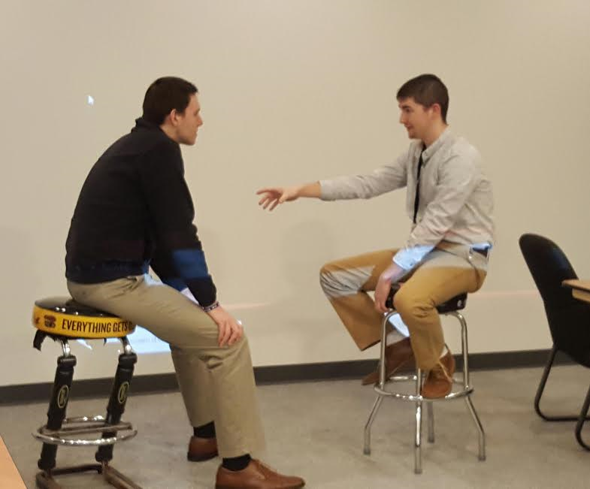
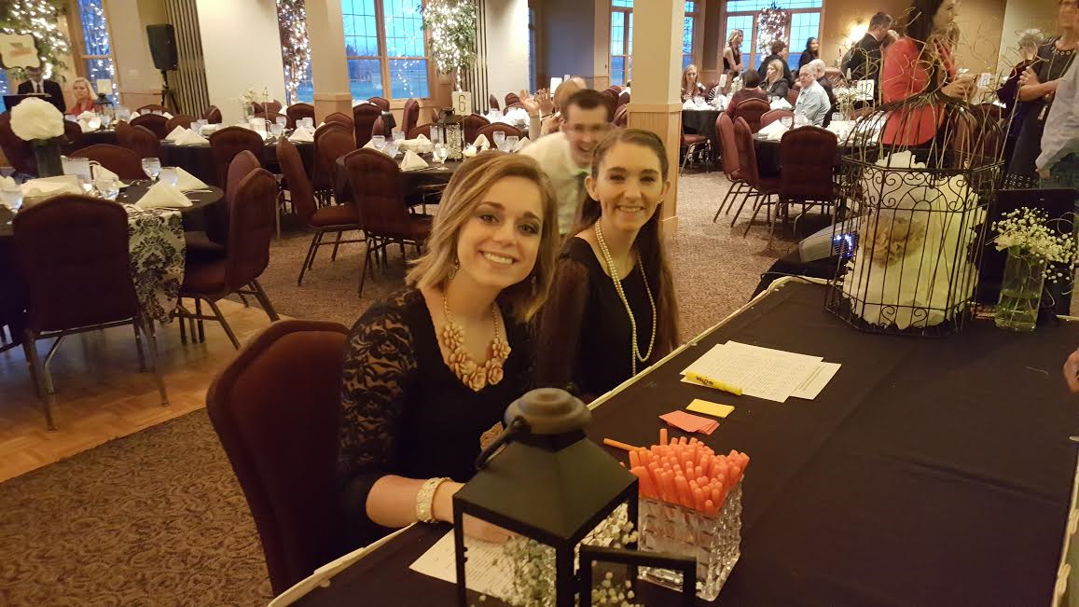
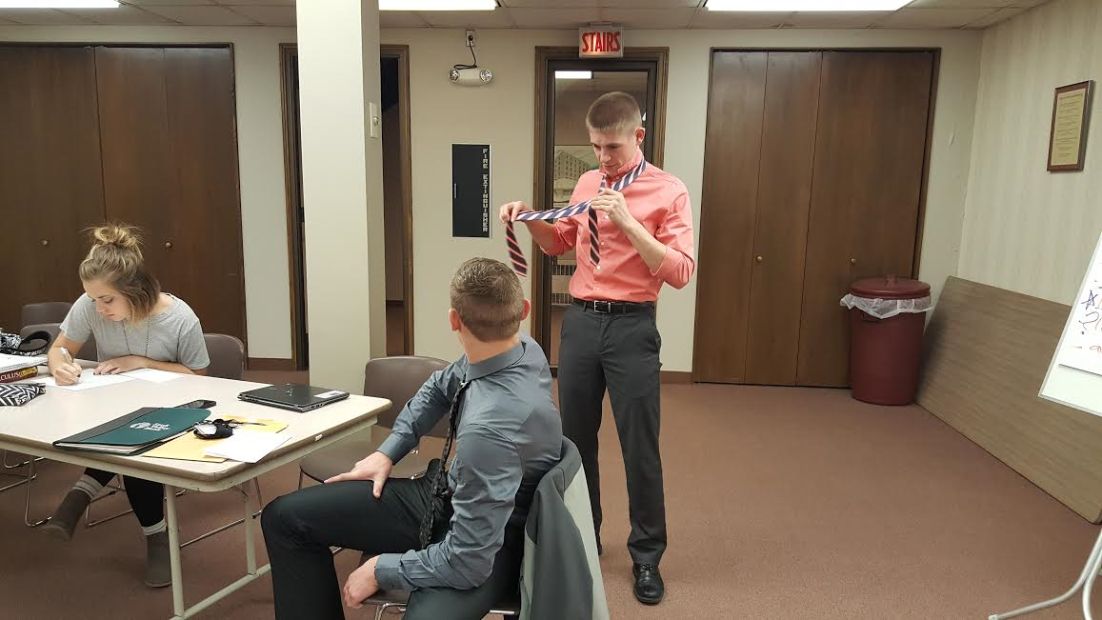
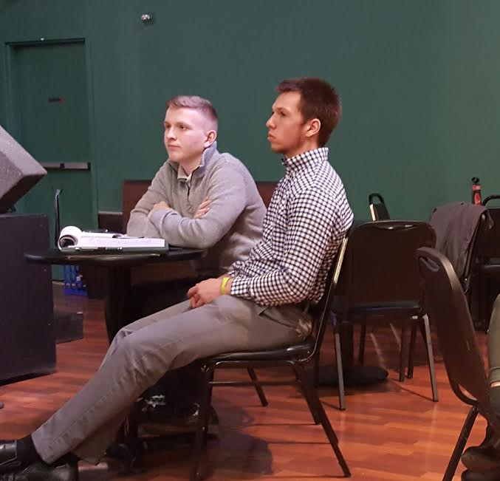
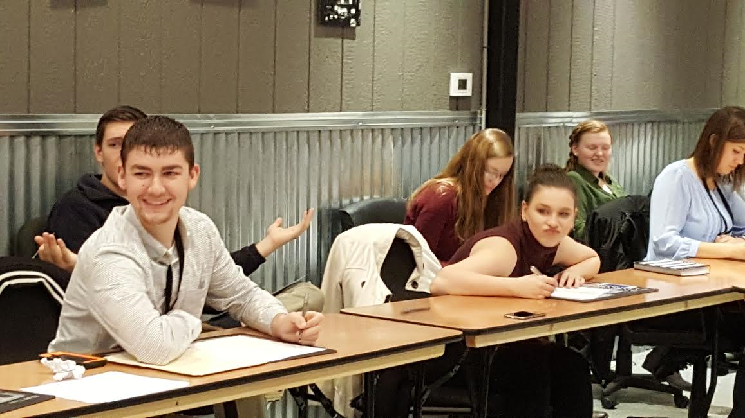
A Few More Stories...
Kyle
Kody
Ross
Madi

Slide 23
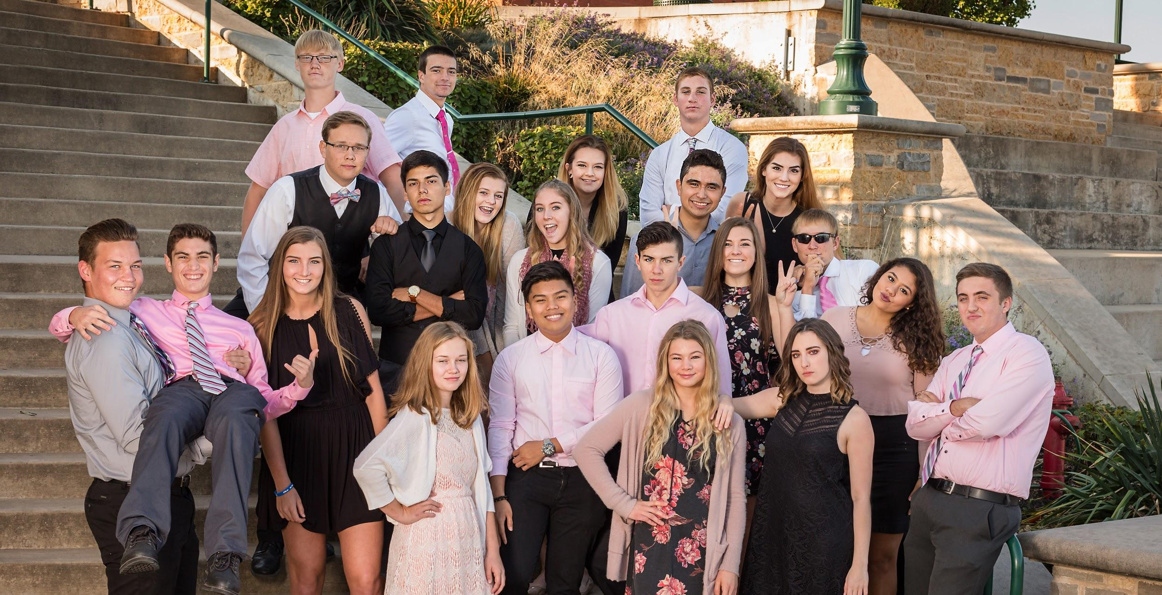
CEO Team 2018

Slide 24
THANKS!
Any questions?
You can find me at
lhartman@wacc.cc
815-291-6472

Slide 25
Sites
www.wacc-ceo.com/
http://www.midlandinstitute.com/
http://www.slidescarnival.com/

