Slide 1

Meta Majors: Pathways
Supporting Students from High School to College and Career
Notes:
HALF OF ILLINOIS HIGH SCHOOL GRADUATES WHO ENROLL IN COMMUNITY COLLEGE REQUIRE REMEDIAL EDUCATION
EMPLOYERS REPORT THAT RECENT HIGH SCHOOL GRADUATES OFTEN LACK CRITICAL SKILLS FOR SUCCESS
Students who

Slide 2

Behavioral Economics: Choice
Too much choice — especially uninformed choice — leads to indecision or poor decisions
On-Time Graduation Rates
(Full-time students)
^{5.0%}

Slide 3
Too Many Credits
2-year
Associate
78.8
credits accumulated
60
credits standard
Notes:
This does not count remediation – bearing in mind around 60% of students test into remediation

Slide 4
Too Many Choices and
Too Little Guidance
Most colleges have more than 100 majors and hundreds of courses
Most students are uncertain about their career interests
45% of students haven’t seen a counselor by the third week of class

Slide 5
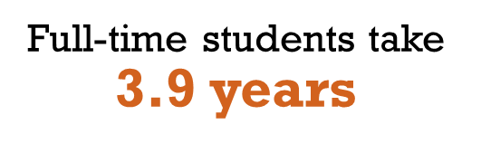
Too Much Time to Degree
Of those who graduate…
2-year
Associate

Slide 6




Students are …
Taking too much time
Taking too many credits
Spending too much money
Not graduating

Slide 7
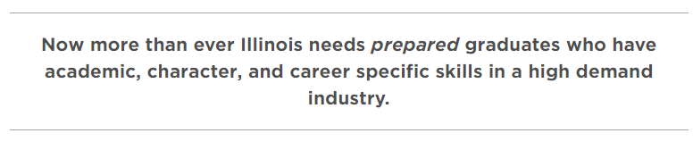
Statewide Initiative: HB 5729
Postsecondary & Workforce Readiness Act
PaCE Initiative
Following local & statewide workforce data
Notes:
HB5729 passed the Illinois House and Senate unanimously in May 2016, and the Governor signed it on July 29, 2016. HB 5729 will implement strategies toward aligning colleges’ and employers’ expectations with elementary and secondary requirements. Advance Illinois and its 60x25 Network team are working to achieve Illinois P-20 Council’s goal of 60 percent of Illinoisans having a high-quality post-secondary certificate or degree by the year 2025.
Refer to handout

Slide 8
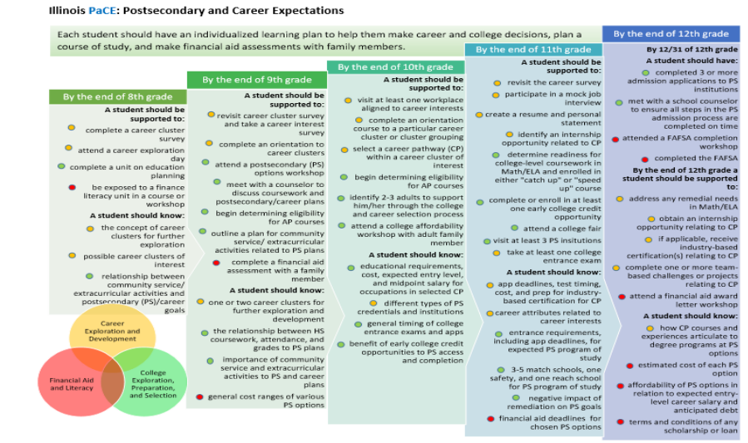
PaCE Initiative
Notes:
The Statewide PaCE initiative will start the process in 8th grade, helping to habituate students to the career exploration process and making informed decision.

Slide 9
Key components include
Default pathways
Informed Choice
Meta-Majors
Academic Maps
Milestone courses
Intrusive advising
Notes:
Through the high school performance and other measures such as assessments and intrusive advising we could to recommend broad academic pathways — “meta-majors”
Informed choices include tying math directly and research on career growth and salary to the meta-majors

Slide 10
What is Sauk working on?
The state of Illinois has identified the following priority pathways :
Finance and Business Services
Health Sciences and Technology
Information Technology
Manufacturing, Engineering, Technology, and Trades
Ag, Food, Natural Resources
Multidisciplinary – arts and communication, human and public services, multidisciplinary
**Bold indicates a priority industry
Notes:
As a result of local and statewide assessments it has been determined where the largest area of career opportunities will land. And this has driven our Meta-majors. We are working to take our 68 transfer degree and AAS options and place them into 8 broad categories.

Slide 11


Slide 12
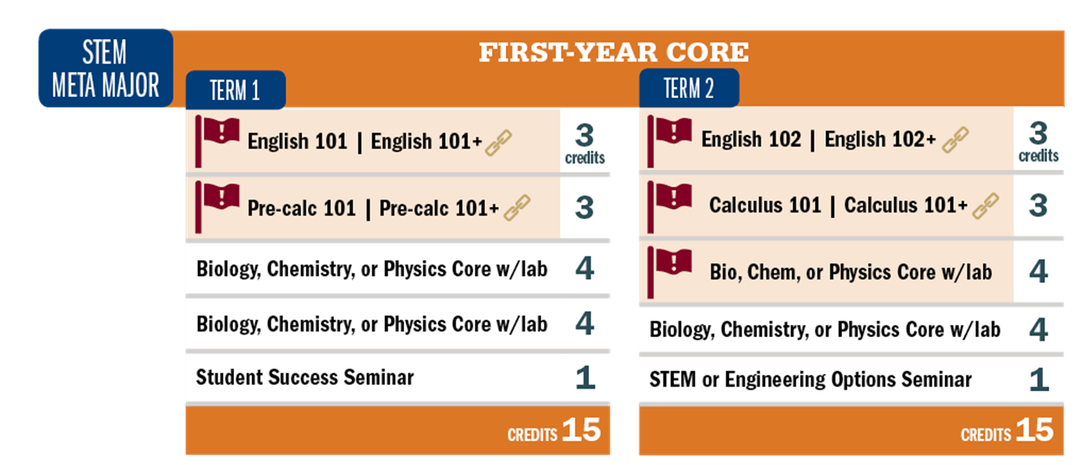
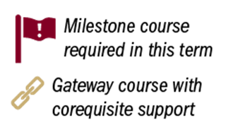
Notes:
The next step will be for Advisors to map default sequences, a common first semester, and develop information for each program (costs, occupational need, transfer destinations, average salaries, etc.), to be included on the College’s website. We hope that the 2019-2020 College Catalog will be developed using these meta-majors, and all students will be placed in a meta-major by the fall of 2019.
Once in a meta-major, advisors help students narrow their study to a Program of Study (major) which will be loaded with courses, if a student opts out of the prescriptive major they would need advisor consent and would be notified of possible impacts (federal funding now requires students to follow their programs of study)
A semester-by-semester academic map is the sequential, prescriptive schedule of classes for the meta-major and the major
This map will drive all advising discussions and will be used in all advising meetings for continuity and accountability

Slide 13
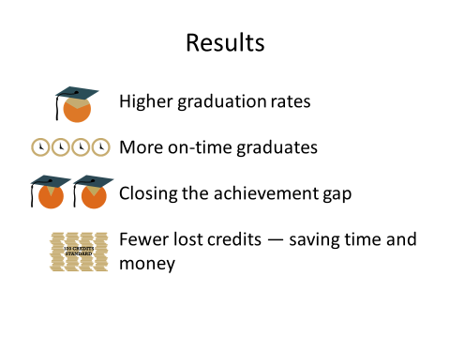
Notes:
This is a high impact practice driven at both the national and statewide levels. As the US tries to ensure competiveness with the 60 by 25 (60% of the citizens will have a credential by the year 2025) research has been poured into initiatives that make are named as “Game Changers” in higher education. Meta-majors is one of four significant initiatives and has proven results. This does not take options away from students, it helps them to focus their talents and make informed choices.

Slide 14
Next Steps
Create Meta-Majors
  Based on Illinois priority pathways
  Place majors within Meta-Majors
  Develop unifying or underlying themes (A Narrative)

Slide 15
Next Steps
Develop core courses for Meta-Majors
  Courses that help explore interest in Meta-Major
  Courses that satisfy both General Education and major requirements
  Courses that are easily transferrable to another major within the Meta-Major

Slide 16
Next Steps
Work closely with other departments
  Must be visually stimulating
  Must be easy to access and utilize
  Must be interactive and linked to resources

Slide 17
Next Steps
Further down the road…
  Meta-Majors should focus not just on student interests, but also on skills
    Interests may indicate one Meta-Major, but skill levels may indicate something else
  Meta-Majors will be linked to career and transfer resources
    We are not the final stop in the pathway or pipeline
  Meta-Majors will be fully incorporated into Sauk advising model

Slide 18
Next Steps
Gathering Input and Feedback…
This is where we need your help!

Slide 19
Contact Info
Joe Bright
815-835-6226
Joe.a.bright@svcc.edu

