Slide 1
SVCC Pass Summit 2018
Success ˚ Student ˚ Advocating ˚ Partnership

Slide 2
The Economic State of the 71st District
Representative Tony McCombie

Slide 3
Biography: Born and raised in Savanna, IL. Received BA from Western Illinois University. Currently is a small businesswoman, operating Blue Appraisals and self-employed in the real estate industry as a broker with Mel Foster Company. Formerly served as the Mayor of Savanna, IL and as a Savanna Councilwoman. She is a citizen legislator who lives in Savanna with her husband, Curt.
Sworn in January 11, 2017
Committee assignments:
Business & Occupational Licenses
Business Incentives for Local Communities, Cities & Villages
Elementary Secondary Education: School Curriculum Policies
Tourism, Hospitality & Craft Industries
Transportation: Regulation, Roads

Slide 4
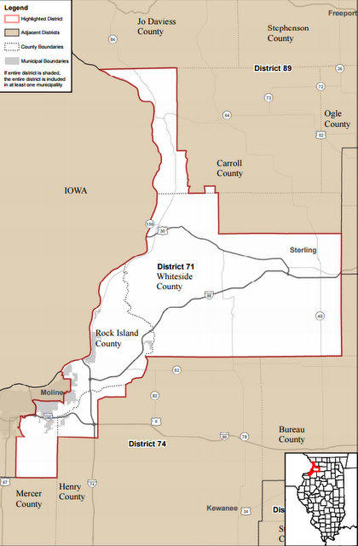

Slide 5
Opening Questions
How many of are originally from the Sauk Valley area?
How many of you returned to the Sauk Valley area?
Have your children stayed in IL for post secondary education/training?
Have your children pursued in the Sauk Valley Region and/or Illinois?
How many of you believe there are no job opportunities in the Sauk Valley area?
Let's use CGH as an example. How many jobs do you think are available at CGH right now?
What are some important skills employers are looking for?
What type of jobs do you think are in demand?

Slide 6
Illinois
Population
  Today….12.77 million
  2015…12.86 million
  2010…12.84 million
Why do people leave?
  School / Employment
  Taxes / Regulations
  Weather / Retirement

Slide 7
Illinois / Sauk Valley
Top Five Categories of Employment Sectors
  Health Care
  Technology
  Education
  Transportation/Distribution/Logistics
  Manufacturing – Skilled
Unemployment Rate
  US – Oct 2017 – 4.1%
  State – Oct 2017 - 4.9%
  Unemployment Rate on Oct 2017: 4.2% in Carroll, 4.6% in Rock Island and 4.4% in Whiteside

Slide 8
Economics of District 71
  Agriculture, Manufacturing, Distribution and Small Business (Service, Retail, Food & Beverage)
  Major employers are Walmart, Wahl Clipper, Exelon, John Deere, our School Districts
  Transportation (Road, Rail, Water & Air)
  Tourism (Trails, Parks, Rivers, Events)

Slide 9
Sauk Valley Challenges
  State of Illinois Budget Issues
    Spending more than we are taking in
    Debt Backlog and Pension Debt
    Out migration due to work, property taxes, & retirement
    Cost of secondary and higher education
    Political and Structural Policies
    Cuts to line items that bring revenue
      Incentives, Marketing Illinois, Projects
  Skills Gap / Health Care Worker & Teacher Shortages
  Proximity to Iowa – Ex. schools, property taxes, workers comps

Slide 10

Mike Rowe – Skills Gap

Slide 11
Are There Jobs?
  Wahl Clipper
    20-25 assembly floor positions open – HS Education
    10-12 high level positions open – 2-4 yrs higher education
  Rock River Aggregate
    2-4 positions in Agronomy – 4 yr – Inner personnel / math skills
  CGH
    46 various positions open – various levels of education
  Frantz
    2 inspectors with mechanical skills needed
  Astec Mobile Screens
    2 machine operators – HS Education
  Sauk Valley Community College
    28 various positions – various levels of education
  Timken Drives, DuPont, 3M, John Deere, Walmart Distribution, Metlife

Slide 12


Slide 13
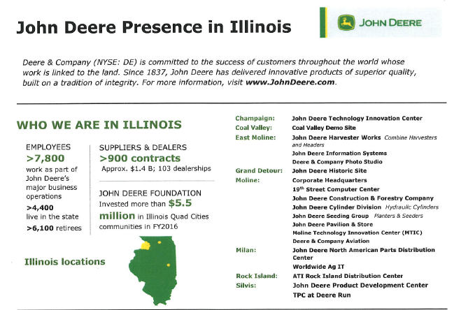

Slide 14
Top Issues from Employers
  Skilled Labor Shortage
  Attendance
  Drug Test
  Work Ethic

Slide 15
Sauk Valley - Positives
  Community Colleges / Technology Schools
    Help close the skills gap
    Future Decision Building
    Establish Roots
  High Schools Programs to build Entrepreneurs / Skilled Labor
    WACC / Vocational Programs
    Ag Programs
    CEO Program / Entrepreneurial Programs
  Diverse Ag Education & Industry
  Quality of Life (Health Care, Housing, Recreation, Proximity to Culture)
  Safe Place to Raise a Family
  Major Business Partners: Wahl Clipper, Exelon; John Deere, Etc
  Proximity to Transportation Corridors

Slide 16
Initiatives to Build our Future
  Provide “shovel ready” opportunities for new companies to come to area.
  Clean Up / Rehab “run-down” areas and improve areas like the riverfront to add appeal to the area.
  Good Schools with class choices, variety, amenities when moving to the area.
  Strong Chambers and Service Clubs to help those less fortunate
  Attempt to bring jobs to the area that are attractive to young people, like software programming, marketing firms, etc

Slide 17
Initiatives to Build our Future
  More programs/partnering with local businesses/community colleges to grow/continue a pipeline to close the skills gap for open and developing positions
  Diversify with non for profit / health sector business
  Capital Bill
  Mississippi Bicentennial Restoration tax credit bill (Halpin/McCombie)
  Political / Structural Reforms

Slide 18
District 71 - QCA

Slide 19
Closing Questions
How many of you believe there are good job opportunities in District 71?
Do you believe there are a variety of jobs in District 71?
How do you engage our youth to believe attendance, loyalty and dedication are important attributes?
Are you able to provide challenges in the work place to encourage longevity, advanced learning/skills, etc
What are you doing to attract candidates to come to the Sauk Valley area and join your team?
Does your workplace offer an internship, apprenticeship, or on-the-job training program to fill your employment gaps?

Slide 20
Thank You!
Please follow me on Social Media at:
Tony McCombie or McCombie for Illi
Visit my website at:
www.repmccombie.com
Or email me at:
mccombie@ilhousegop.com

