Slide 1

WHO AM I?
Brent Baker
B.S. in Psychology from Bradley University
Americorps Alumnus
  Two years of service at the Peoria Housing Authority
Peoria Pathways to Prosperity Coordinator at the Greater Peoria Economic Development Council
President of Bike Peoria NFP
Board member of Yaku Peoria

Slide 2
PEORIA & PEORIA PUBLIC SCHOOLS
Context & Demographics
Peoria Public Schools
Population: 13,675
  23% White
  57% Black
  10% Hispanic
  2% Asian
Low-Income Rate: 75%
Mobility Rate: 21%
Chronic Truancy Rate: 18%
Graduation Rate: 65%
  83% Asian
  73% White
  70% Hispanic
  57% Black
Peoria
Population: 115,007
  62% White
  27% Black
  5% Hispanic
  2% Asian
Youth (16 – 19) Unemployment: 29%
Adult (20 – 64) Unemployment: 8%
  Asian: 6%
  White: 7%
  Hispanic: 12%
  Black: 21%
Poverty Rate: 22%
  Asian: 10%
  White: 15%
  Hispanic: 30%
  Black: 40%

Slide 3
PEORIA PATHWAYS TO PROSPERITY
History and Background
Spring, 2014
Mayor Ardis invited executives from Peoria Public Schools, Peoria Federation of Teachers, CEO Council, Peoria Chamber of Commerce, Illinois Central College, Illinois Student Assistance Commission, Illinois Pathways Initiative, and Greater Peoria Workforce Alliance to participate in conversation with George Letavish, Illinois Governor’s office to consider the possibility of joining the Pathways to Prosperity Network.
These (stakeholders) agreed to bind together to form a Peoria Pathways to Prosperity (PP2P) team to study education to career challenges facing students matriculating through the Peoria Public Schools and to recommend improvements.
June, 2014
A Joint Resolution was approved by the respective boards and signed by all the partners.
The PP2P stakeholders identified individuals to serve on the PP2P working
team and met regularly with JFF to conduct asset mapping, which
concluded in the summer of 2014

Slide 4
PEORIA PATHWAYS TO PROSPERITY
History and Background
Fall 2014 – Spring 2015
The JFF report identified healthcare and manufacturing as the leading employment sectors and outlined the gaps in the talent pipelines leading to those career areas.
The report also called for greater alignment between Peoria Public Schools and Illinois Central College’s curriculum leading to these occupation.
Finally, private sector businesses were called on to collaborate with education by creating work‐based learning opportunities for Peoria youth.
June, 2015
Submitted and received a $65,000 Innovation Fund Grant from the American Federation of Teachers, imbuing new life into the Pathways effort. Peoria was among New York, Pittsburgh, Miami, and San Francisco.
This Innovation Fund Grant allowed PP2P to hire a full-time coordinator and
also provided support for the purchase of the 3 year license of the Career Cruising Inspire software.
I was hired as the full time Peoria Pathways Coordinator in August of 2016.

Slide 5
PEORIA PATHWAYS TO PROSPERITY
History and Background
GPEDC
City of Peoria
Peoria Public Schools
Peoria Federation of Teachers
Illinois Central College
MidState College
Peoria Area Chamber of Commerce
CEO Council
Peoria Regional Office of Education
Local EFE
(Ex Officio)

Slide 6
PEORIA PATHWAYS TO PROSPERITY
Goals
Create and connect high-impact Career Development Opportunities (internships, employment, etc.) for Peoria Public Schools high school students, using a platform called Career Cruising Greater Peoria Works; successfully place at least 50 internships by June 2017.
Assist in creating, aligning, and embedding early college credit in PPS High Schools in collaboration with Illinois Central College, working to implement a more intentional career pathways model.
Increase College/Career-readiness, and high school completion rates of Peoria Public Schools students.
Increase local talent pool to meet the increasing regional market demands.

Slide 7
SEQUENCING CAREER PATHWAYS
History
Previous Peoria Public School (PPS) administration had a loose understanding of the career pathways framework; it was not a priority codified in their strategic plan.
With new leadership in the summer of 2016 came a fundamental shift in thinking towards making high school curriculum more engaging, rigorous, and relevant to students’ career ambitions.
Academic Instructional Officer Tom Welsh was made the Career Pathways liaison, charged with building out a more robust pathways model with the help of the Peoria Pathways to Prosperity partnership; we were able to move forward!
Monthly meetings with PPS administrators and Illinois Central College staff were rescheduled to re-innervate the Pathways conversations.

Slide 8
SEQUENCING CAREER PATHWAYS
Timeline & Process
August 22nd, 2016
  Initial Pathways conversation with Tom Welsh
  Established a new understanding of Career Pathways: “An intentional sequence of courses guiding students towards concrete next steps aimed at career success.”
Sept. 28th, 2016
  First school improvement session with high school counselors
    Invited all 12 high school counselors to participate in four hour planning exercise.
    Split counselors into three teams, with each team assigned five career pathways (of the 16 outlined by the Department of Education)
    The Challenge: provide an intentional, recommended sequence of courses - given the context of each career cluster – that a student could follow from grade nine through twelve.

Slide 9
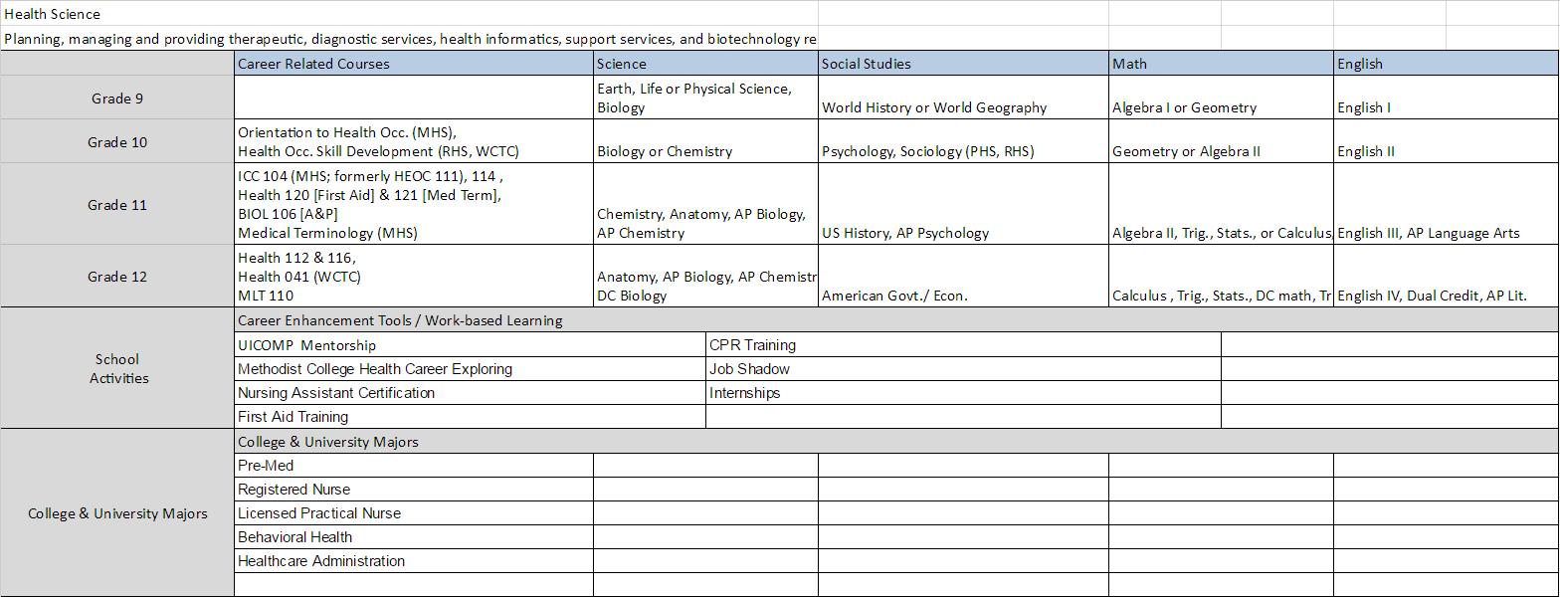
PATHWAYS SKETCH AFTER 1ST COUNSELOR MEETING

Slide 10
SEQUENCING CAREER PATHWAYS
Timeline & Process
Sept. 29th – Oct. 25th, 2016
  After initial sequencing of Pathways with high school counselors, our Illinois Central College (ICC) partner, Judy Dietrich, worked with relevant ICC deans to input all of the certification, degree, and transfer degree programs into our framework.
Oct. 24th, 2016
  Met with ICC deans for an in-person, page-turn review of the 16 cluster sequences.
Oct. 26th, 2016
  Invited all 12 high school counselors back to participate in a final quality-control review of Pathways guide.
Nov. 29th – Dec. 7th 2016
  Final review with University of Illinois’ Dr. Hackmann from and his grad department of our Pathways guide, and finally out to print.
January 2nd, 2017
  Pathways guides distributed to schools for use in upcoming registration.

Slide 11
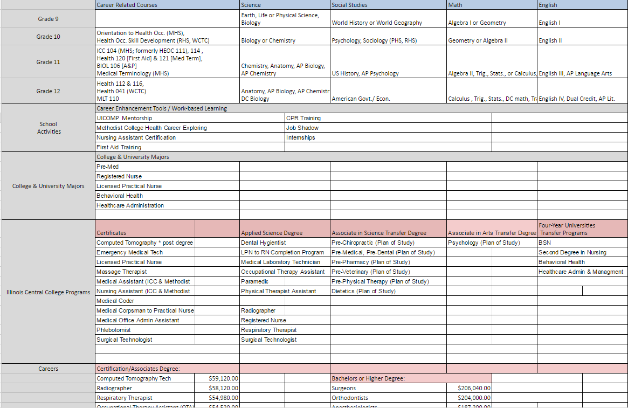
PATHWAYS GUIDE AFTER ICC INPUT

Slide 12
SEQUENCING CAREER PATHWAYS
Timeline & Process
Sept. 29th – Oct. 25th, 2016
  After initial sequencing of Pathways with high school counselors, our Illinois Central College (ICC) partner, Judy Dietrich, worked with relevant ICC deans to input all of the certification, degree, and transfer degree programs into our framework.
Oct. 24th, 2016
  Met with ICC deans for an in-person, page-turn review of the 16 cluster sequences.
Oct. 26th, 2016
  Invited all 12 high school counselors back to participate in a final quality-control review of Pathways guide.
Nov. 29th – Dec. 7th 2016
  Final review with University of Illinois’ Dr. Hackmann from and his grad department of our Pathways guide, and finally out to print.
January 2nd, 2017
  Pathways guides distributed to schools for use in upcoming registration.

Slide 13
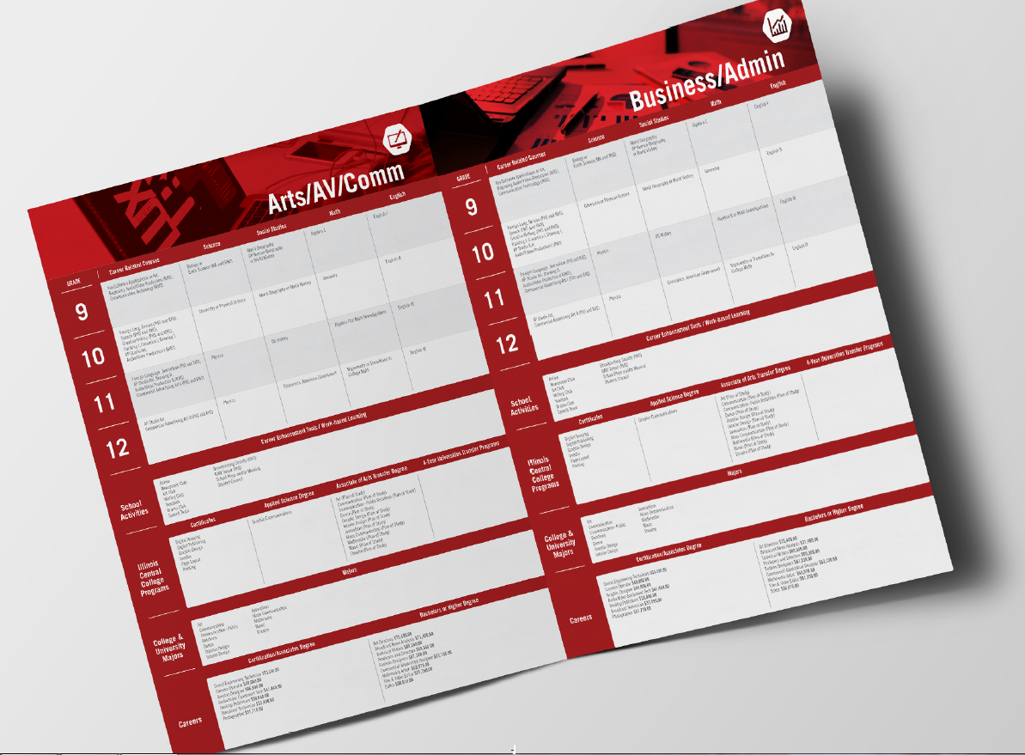
PATHWAYS GUIDE AFTER COMPLETION

Slide 14
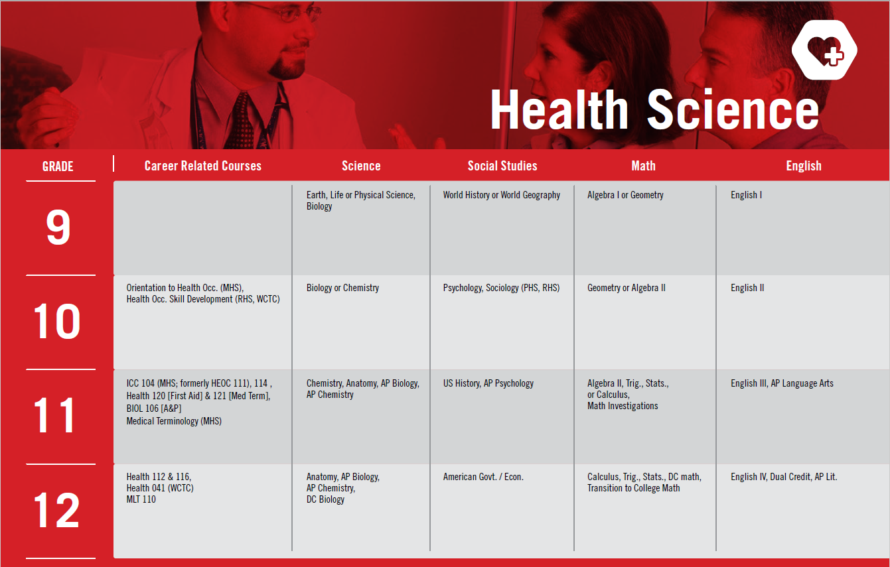
PATHWAYS GUIDE AFTER COMPLETION

Slide 15
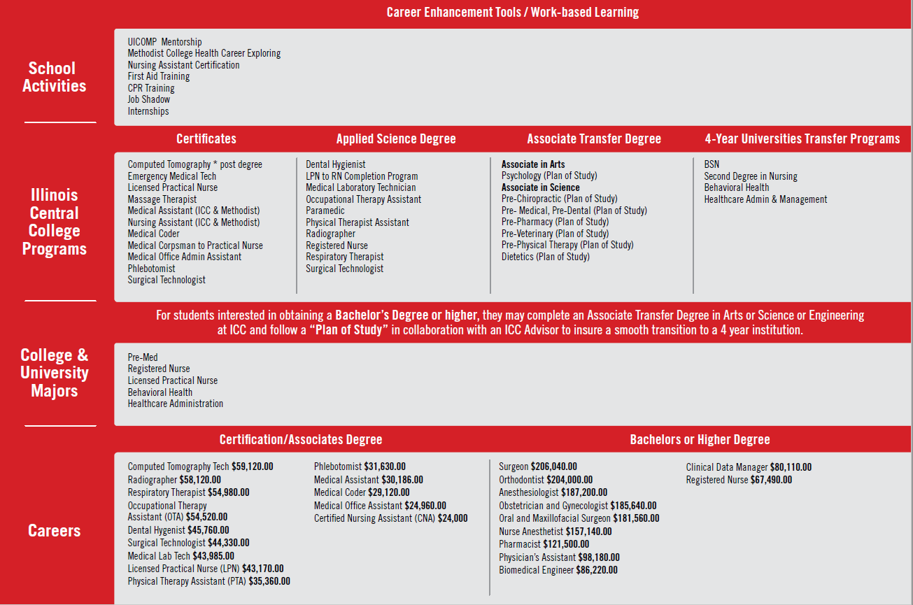
PATHWAYS GUIDE AFTER COMPLETION

Slide 16
SEQUENCING CAREER PATHWAYS
Obstacles & Challenges
Shining Brighter Light on Intra-District Inequities
  This process highlighted the deep programming inequities between the three traditional high schools and CTE center; these inequities existed before, they’re know made more clear.
How Rigid a Pathways System?
  We struggled with how students would select a pathway and if they would have to ‘lock-into’ a pathway by a certain grade.
  Ultimately, we ended up with providing a ‘recommended sequence of courses’ given a students interest with ongoing efforts to refine and bolster the pathways model.
Generality More Challenging Than Specificity
  Simply, it was harder to think generally instead of more specific programs of study; will improve in future iterations.
Don’t Let Perfect Stop Progress
  Enough said.
District-Specific Graduation Requirements May Impede Pathways Enrollment
  With the current graduation requirements, students have limited opportunities for electives; will improve in future iterations.

Slide 17
SEQUENCING CAREER PATHWAYS
Future Directions
Refining and Sequencing Pathways/Programs of Study; Adding More Early College Credit
  Specifically in healthcare occupations, IT, Engineering/Manufacturing, and Eduaction/Training.
Illinois Post-Workforce Readiness Act Pilot
  Scaling competency-based approaches in key pathways.
Engaging Industry Leaders to Engage in Pathways Sequencing
  Working to build in capstone external experiences.
  Also, working to ensure students are provided needed/marketable skills
Ensuring Rising Middle Schoolers Have Opportunities to Explore Careers
  Through Career Cruising and New Horizons Club (career exploration lunch-and-learn program).
Tackling Graduation Requirement Obstacle
  Reviewing and reforming requirements to open more career-relevant elective options to high school students.

Slide 18
SCALING CAREER PATHWAYS
Future Directions
Codifying Career Pathways
  Built GP Pathways web portal to capture successfully mapped regional pathways
  Aligning with new State of Illinois Career Pathways Endorsement Portal
  Beginning to onboard local districts in inputting data into new portal for endorsement review
Building ESSA Competency and Capacity
  Hosting regional Pathways Summits to regulary and consistently engagement district leadership.
  Focused on scaling pathways mapping, sharing college and career readiness resources, and bolstering superintendent understanding of new expectations
Backmapping New Pre-Apprenticeship Programs
  Work with Illinois Central College partners to map apprenticeship and pre-apprenticehip competencies to junior and senior high school coursework to further bolster pathways endorsement model
  Work to adopt shared ‘Essential Skill’ framework, expectations, and curriculum across school district and community partners, aligned to PWR/ESSA expectations.
Data & Accountability Systems
  Establish key shared metrics for key local secondary and post-secondary indicators and data sharing agreements to support accountability.
  Align key partners to establish an accountability team to assess data semi-annually.

Slide 19

THANK YOU
bbaker@greaterpeoriaedc.org | 309.696.4733
Notes:
************
ADD AT THE END OF EACH PRESENTATION.
*************

