Slide 1
PASS SUMMIT
FEBRUARY 1, 2019

Slide 2
Transitional Mathematics

Slide 3
PWR Act
Public Act 99-0674 (HB 5729); signed by Governor on 7/29/16
Four components:
  1. Postsecondary and Career Expectations (PaCE)
  2. Pilot of Competency-based High School Graduation Requirements
  3. Scaling of 12th Grade Transitional Courses
  4. College & Career Pathway Endorsements on High School Diplomas

Slide 4
By the Numbers
On average, 50% of IL HS graduates are placed into remedial education.
Fewer than 40% of CC students complete any type of degree or certificate within six years (Source: Bailey, 2015). Remediation plays a role. Individuals without a degree or certificate have dramatically reduced earning potential (Source: Belfield and Bailey, 2017).
By 2020, 65% of all jobs in the economy will require postsecondary education and training beyond high school.*
8 out of 10 Illinois employers say they need employees with some postsecondary education (Source: 60by25.org).
*Recovery: Job Growth and Education Requirements, Georgetown University

Slide 5
Goal: reduce Remediation
Determine who is not college-ready for math in the junior year.
Remediate with new transitional courses in the senior year.
Provide guaranteed placement at all IL community colleges and some universities. Result: Students start at college-level coursework, increasing their chances of completing a certificate or degree.
This initiative is about more than completing a class, but instead a degree or certificate

Slide 6
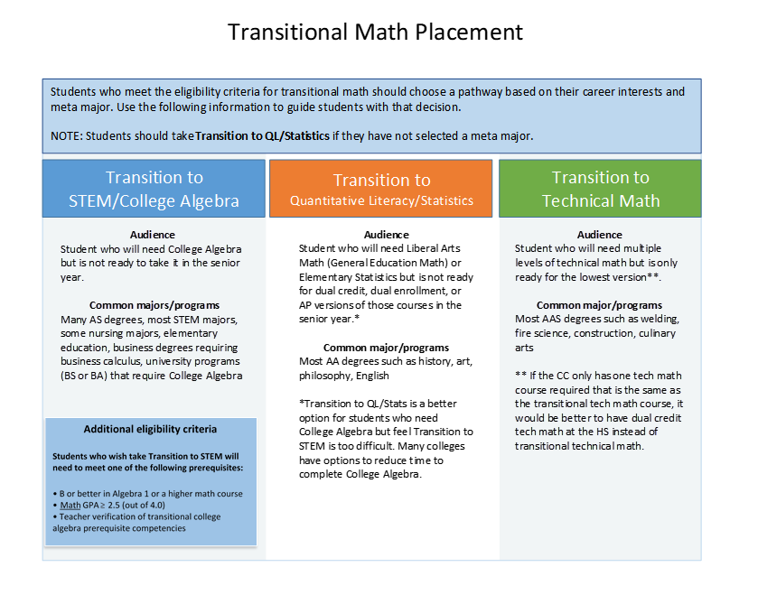

Slide 7
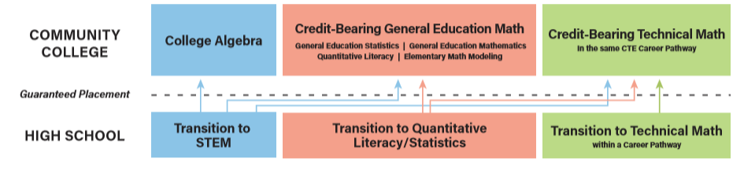

Slide 8
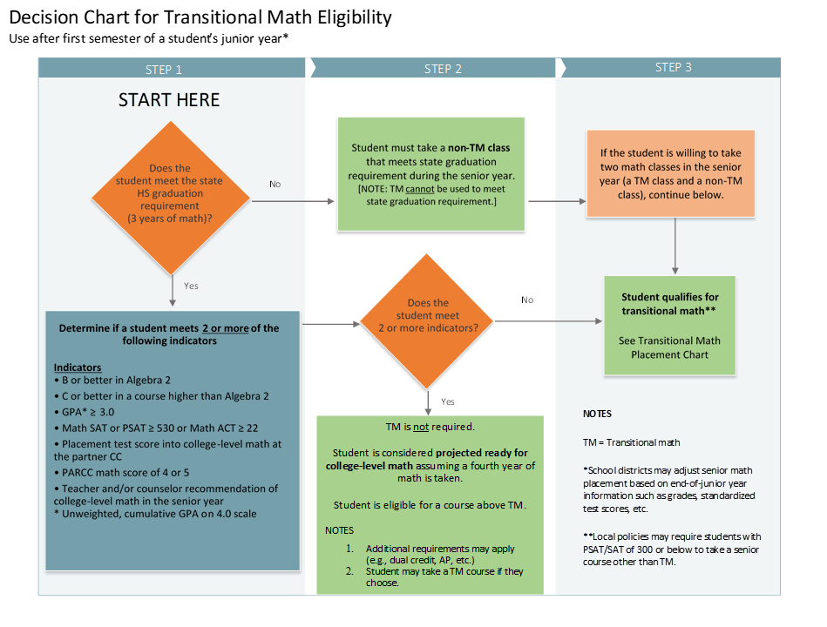
Algebra 2 is NOT a pre-requisite.

Slide 9
Decision Making Process
Placement guidelines for juniors are state policy and NOT optional.
Placement done after first semester of junior year; can be refined in spring.
Students should be placed into the highest course for which they can be successful. Many students can pick their major from its math requirements.
When in doubt, use the QL pathway (default by law).
PWR TM does not meet the 3rd year state graduation requirement.
A fourth year of math is not required, but should be strongly encouraged. Students lose readiness when sitting out their senior year.

Slide 10
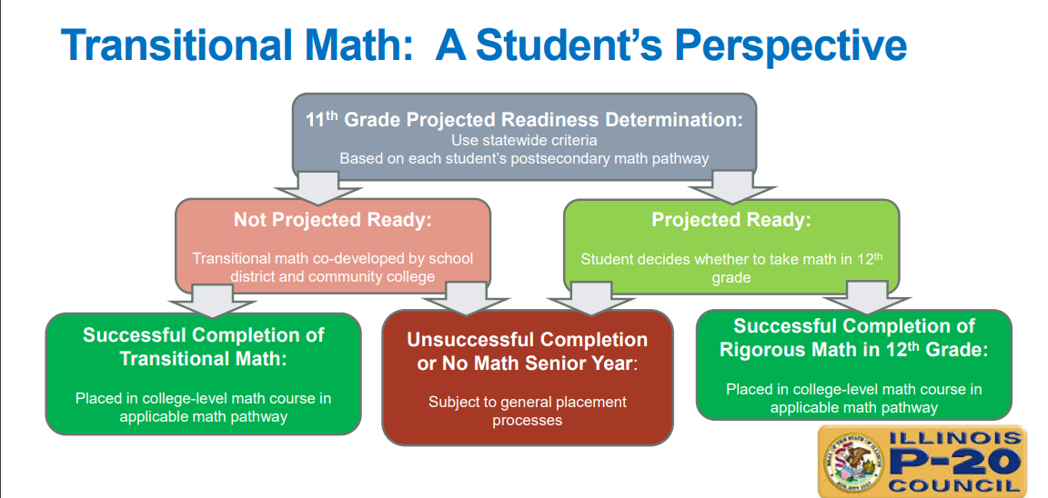

Slide 11
Teacher Requirements
A teacher must be certified to teach high school math to teach a standalone transitional math course.
If transitional math instruction is integrated with other academic or career-focused content (such as in a senior year capstone course) or taught through a competency-based instructional model, the role of the high school math teacher or community college math instructor must be addressed in the Memo of Understanding, and can range from co-teaching to serving in a resource role when needed.
As transitional math courses are not for college credit, a teacher need not meet postsecondary accreditation requirements applicable to community college faculty.

Slide 12
TM Course Beliefs
Students should be provided mathematics instruction aligned to their individualized post-secondary education & career objectives
Math instruction should be contextualized and emphasize real-world application whenever possible, and instructional strategies integrating math competencies with other academic and career competencies are encouraged for all students.
This is NOT a longer, louder math course

Slide 13
Course Requirements
Course must address competencies
The high school and college must agree to a grading structure that will include formative and summative assessments such that receiving a C or better indicates the competencies for the course were met and the student is considered ready for college-level math coursework in the appropriate pathway.
Grading standards that support college readiness should be mutually established between the high school and college. Specifically, agreed upon grading standards must meet the following guidelines:
  At least 25% of the overall grade must come from problem or project-based learning tasks.
  A single assessment may not be more than 50% of the final grade in the course.
  No more than 25% of the course grade can come from formative assignments such as homework.
  Data must be used to evaluate the effectiveness of any transitional math course. Outcomes in the subsequent college-level math courses will inform ongoing adjustments to the transitional math courses.
  Grading policies stated in the Memo of Understanding take precedence over any conflicting local grading requirements due to the placement and portability agreements.

Slide 14
Procedures
High schools and community college co-develop a course, course syllabus, and MOU.
Portability Panel approves all submissions.
If the student passed the course with a “C” or better, this will be recorded on their transcript.

Slide 15
Timeline
ICCB, ISBE, IBHE work collaboratively to develop a model TM units of instruction. (2018-19)
Piloting of model TM units & tasks (spring 2019)
Professional learning provided for implementation of transitional math courses (summer 2019-2020)
By no later than June 30, 2019, ISBE and ICCB shall jointly establish a phased implementation plan and benchmarks that lead to full statewide implementation of transitional mathematics instruction in all school districts with timeframes that account for State and local resources and capacity.

Slide 16
Website
http://www2.iccb.org/iltransitionalmath/

Slide 17
Local Work

Slide 18
18-19 SY Pilot
This School Year AFC (Sean Waters) and Rock Falls (Deena Gallentine) were apart of piloting the Quantitative Literacy & Statistics course (middle of the three).
Both teachers felt that they may not have the proper clientele in the course, but for different reasons.
There were many ups and downs throughout the 1st semester, but we hope that everyone can learn from this for the future.

Slide 19
18-19 SY Pilot – Unit 1
The title of Unit 1 was Personal Finance. Neither of the pilot teachers were too pleased with the implementation of this unit.
Some of the teacher feedback was that the summative assessment would be better suited as a task and one of the tasks would be more appropriate for a summative assessment.
Some of the student feedback was that this unit was too similar to their consumer education course.
Changes have been made based off this feedback to improve the unit for the 19-20 SY.

Slide 20
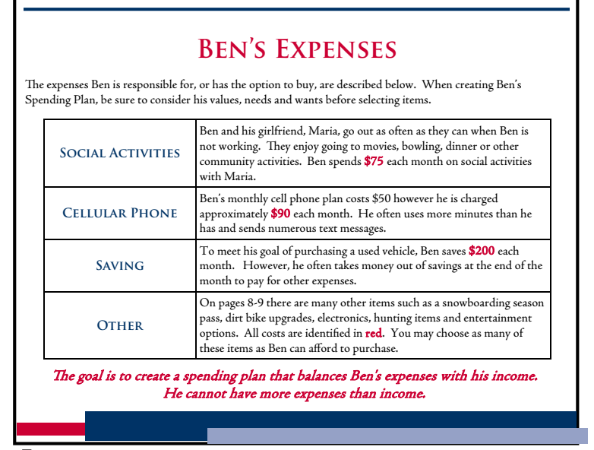
18-19 SY Pilot – Unit 1
Subsections in this unit included:
  Financial Well Being
  Managing Your Money
  Earning
  Saving & Investing
  Spending, Borrowing, & Protecting
One of the tasks that I enjoyed with titled “The life of… “

Slide 21
18-19 SY Pilot – Unit 2
The title of Unit 2 was Statistics & Predictions. Unit 2 seemed to be received a lot better than unit 1.
Subsections in this unit include:
  Statistical Calculations & Displays
  Probability & Predictions
  Predictions Between Two Quantities
I would like to see us have more time for this unit, maybe by making unit 1 shorter.

Slide 22
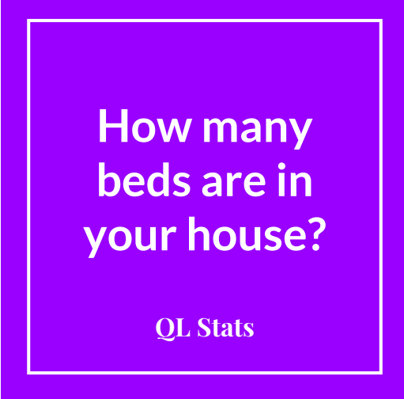
18-19 SY Pilot – Unit 2
Are we normal? – Student Sample
https://docs.google.com/presentation/d/1UAjIMMhpsMXoEipdX9krt3ljDAddln9uBo9Aw0EzxvQ/edit?usp=sharing
Summative Assessment – Student Sample
Combined all ideas of unit better than old Unit 1 Assessment.
Still some training is needed on how to grade something like this using provided rubric.
https://docs.google.com/document/d/1m438t_MeVgZuOD7RalBeQCGWEICk-DunajOPlUHBEmI/edit?usp=sharing

Slide 23
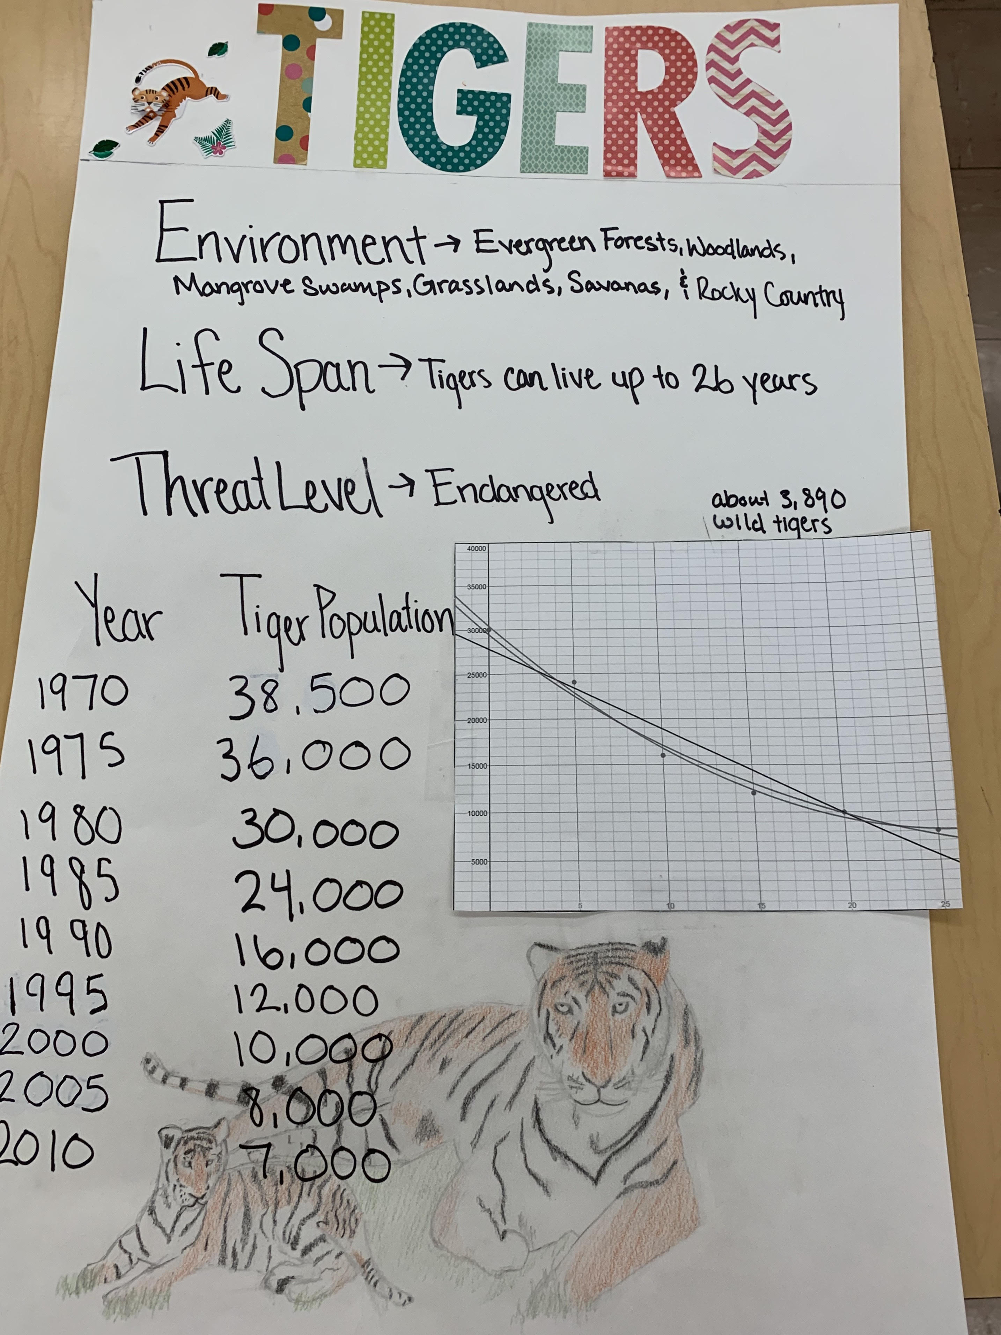
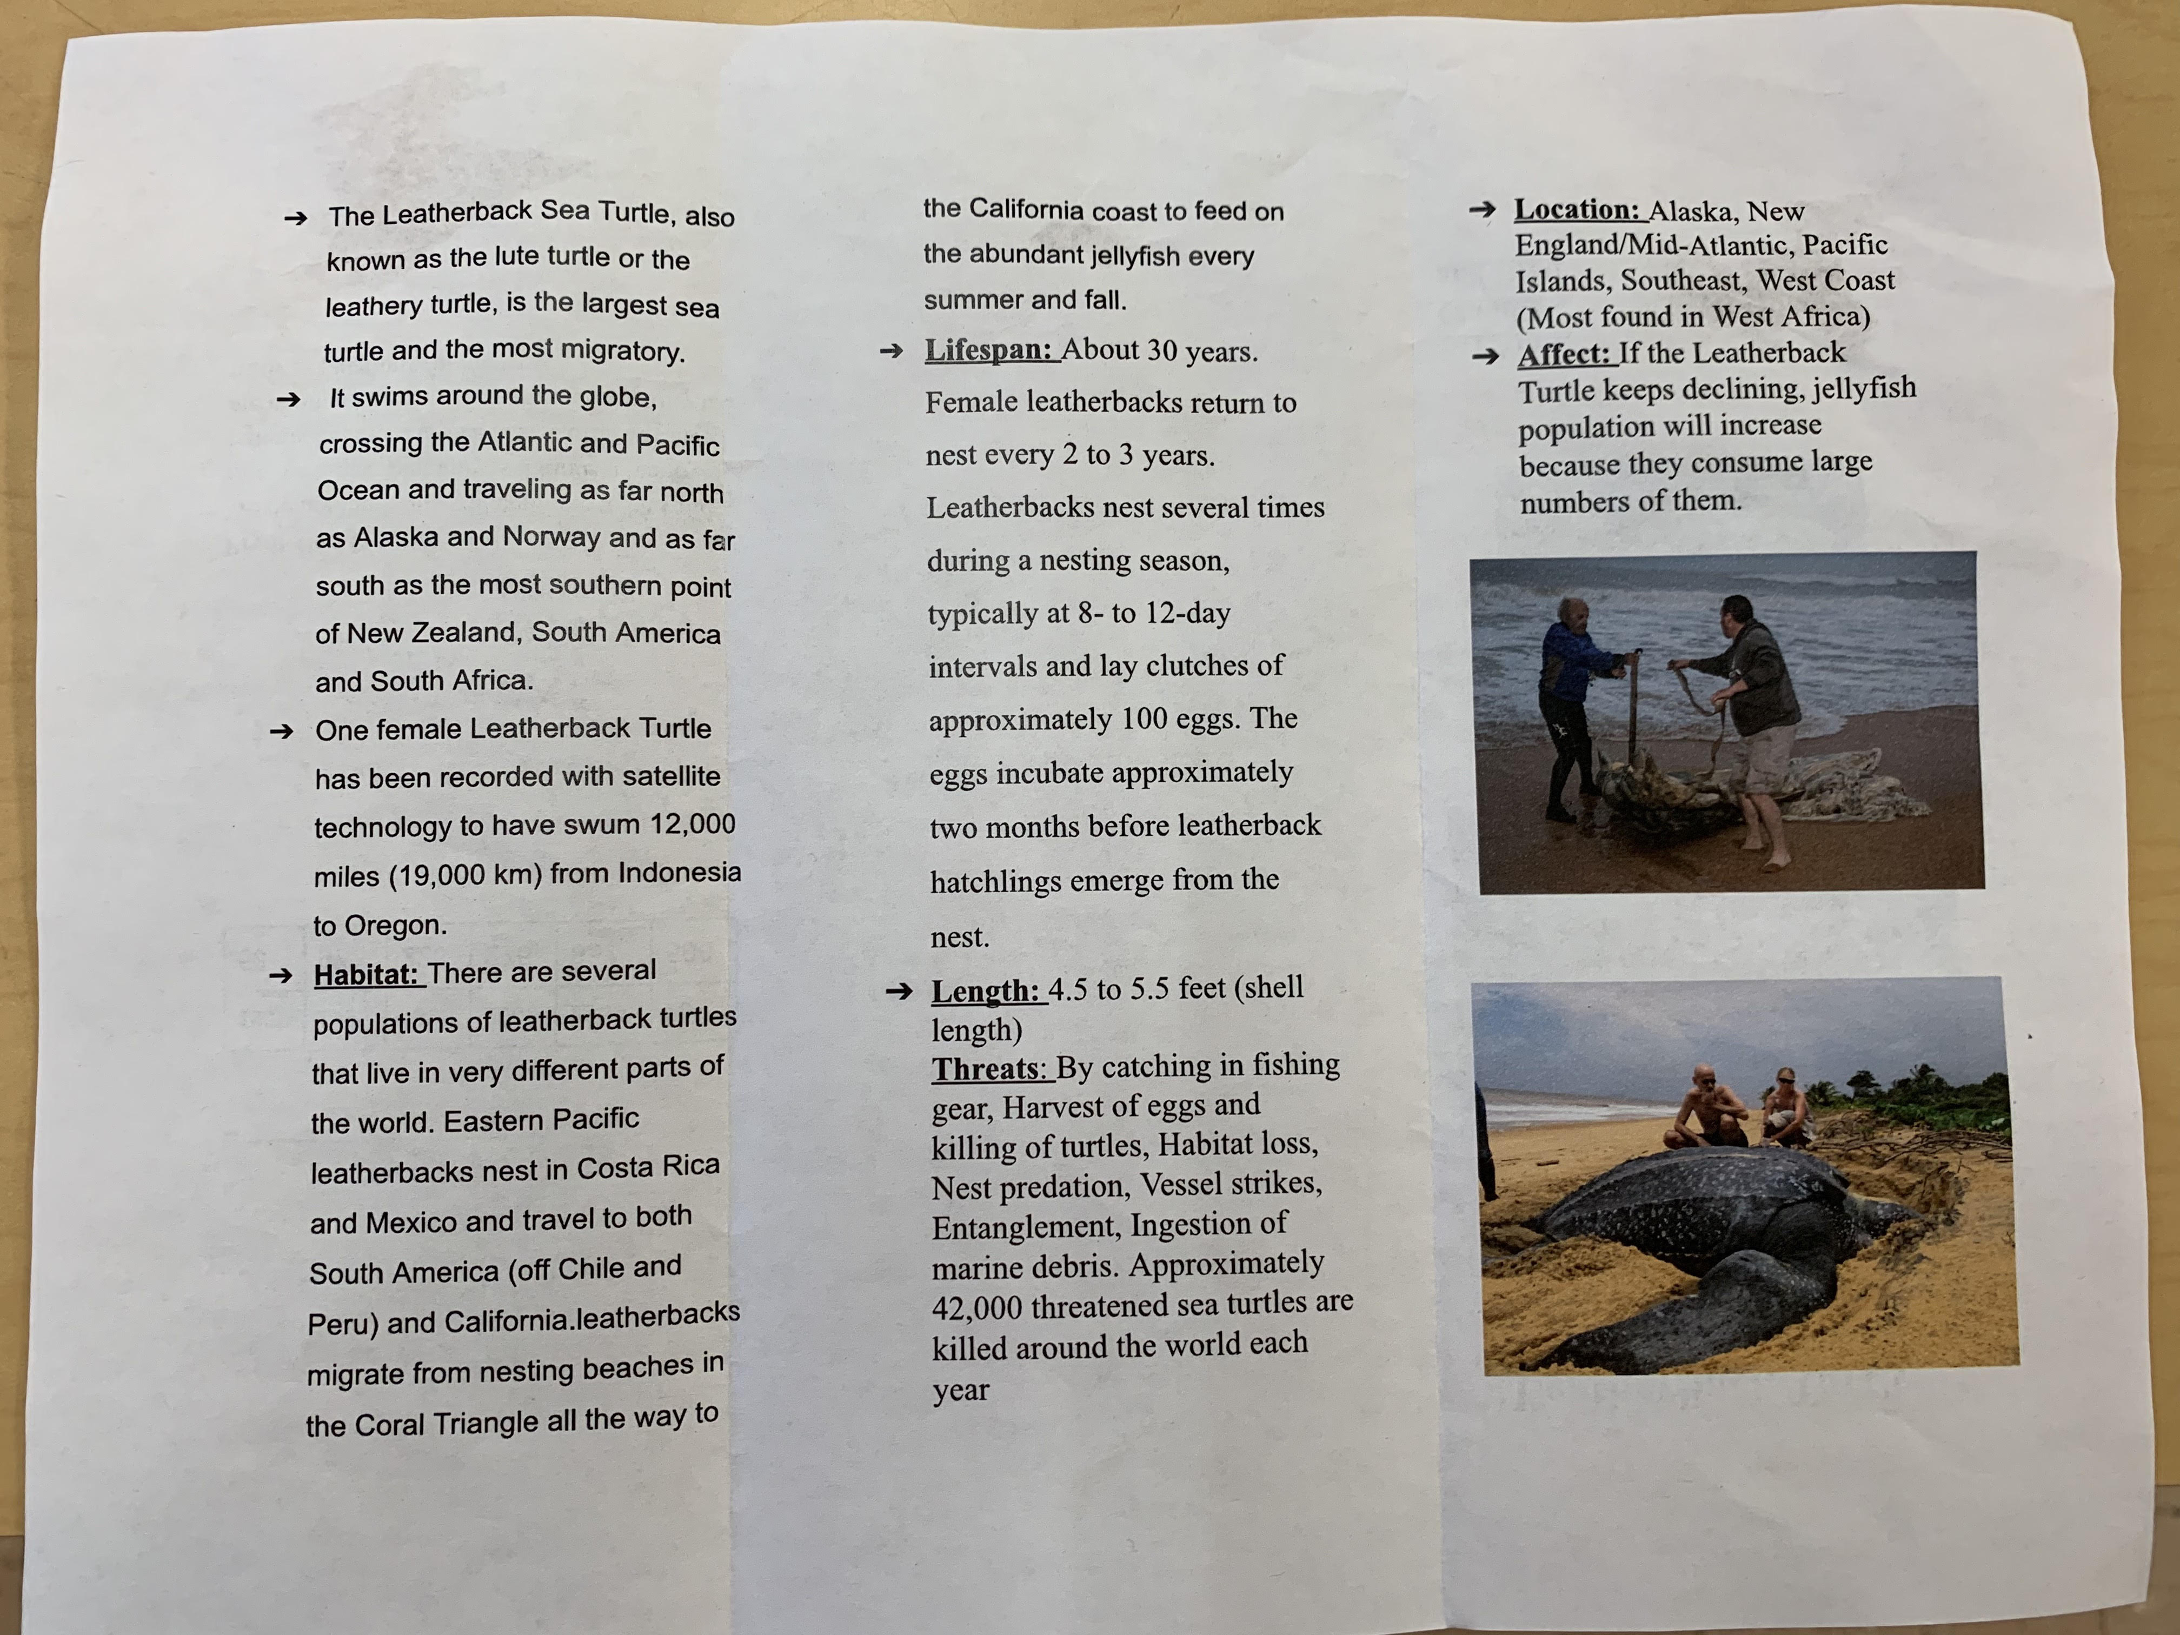
18-19 SY Pilot – Unit 2

Slide 24
18-19 SY Pilot – Unit 3
The new title of Unit 3 was Analyzing and Optimizing Our World. This was changed from Constructing our World because this seemed to only really apply to the first subsection.
Subsections in this unit include:
  Geometry Justification
  Quadratics
  Polynomials
The first two subsections occurred before winter break with the third being after winter break.

Slide 25
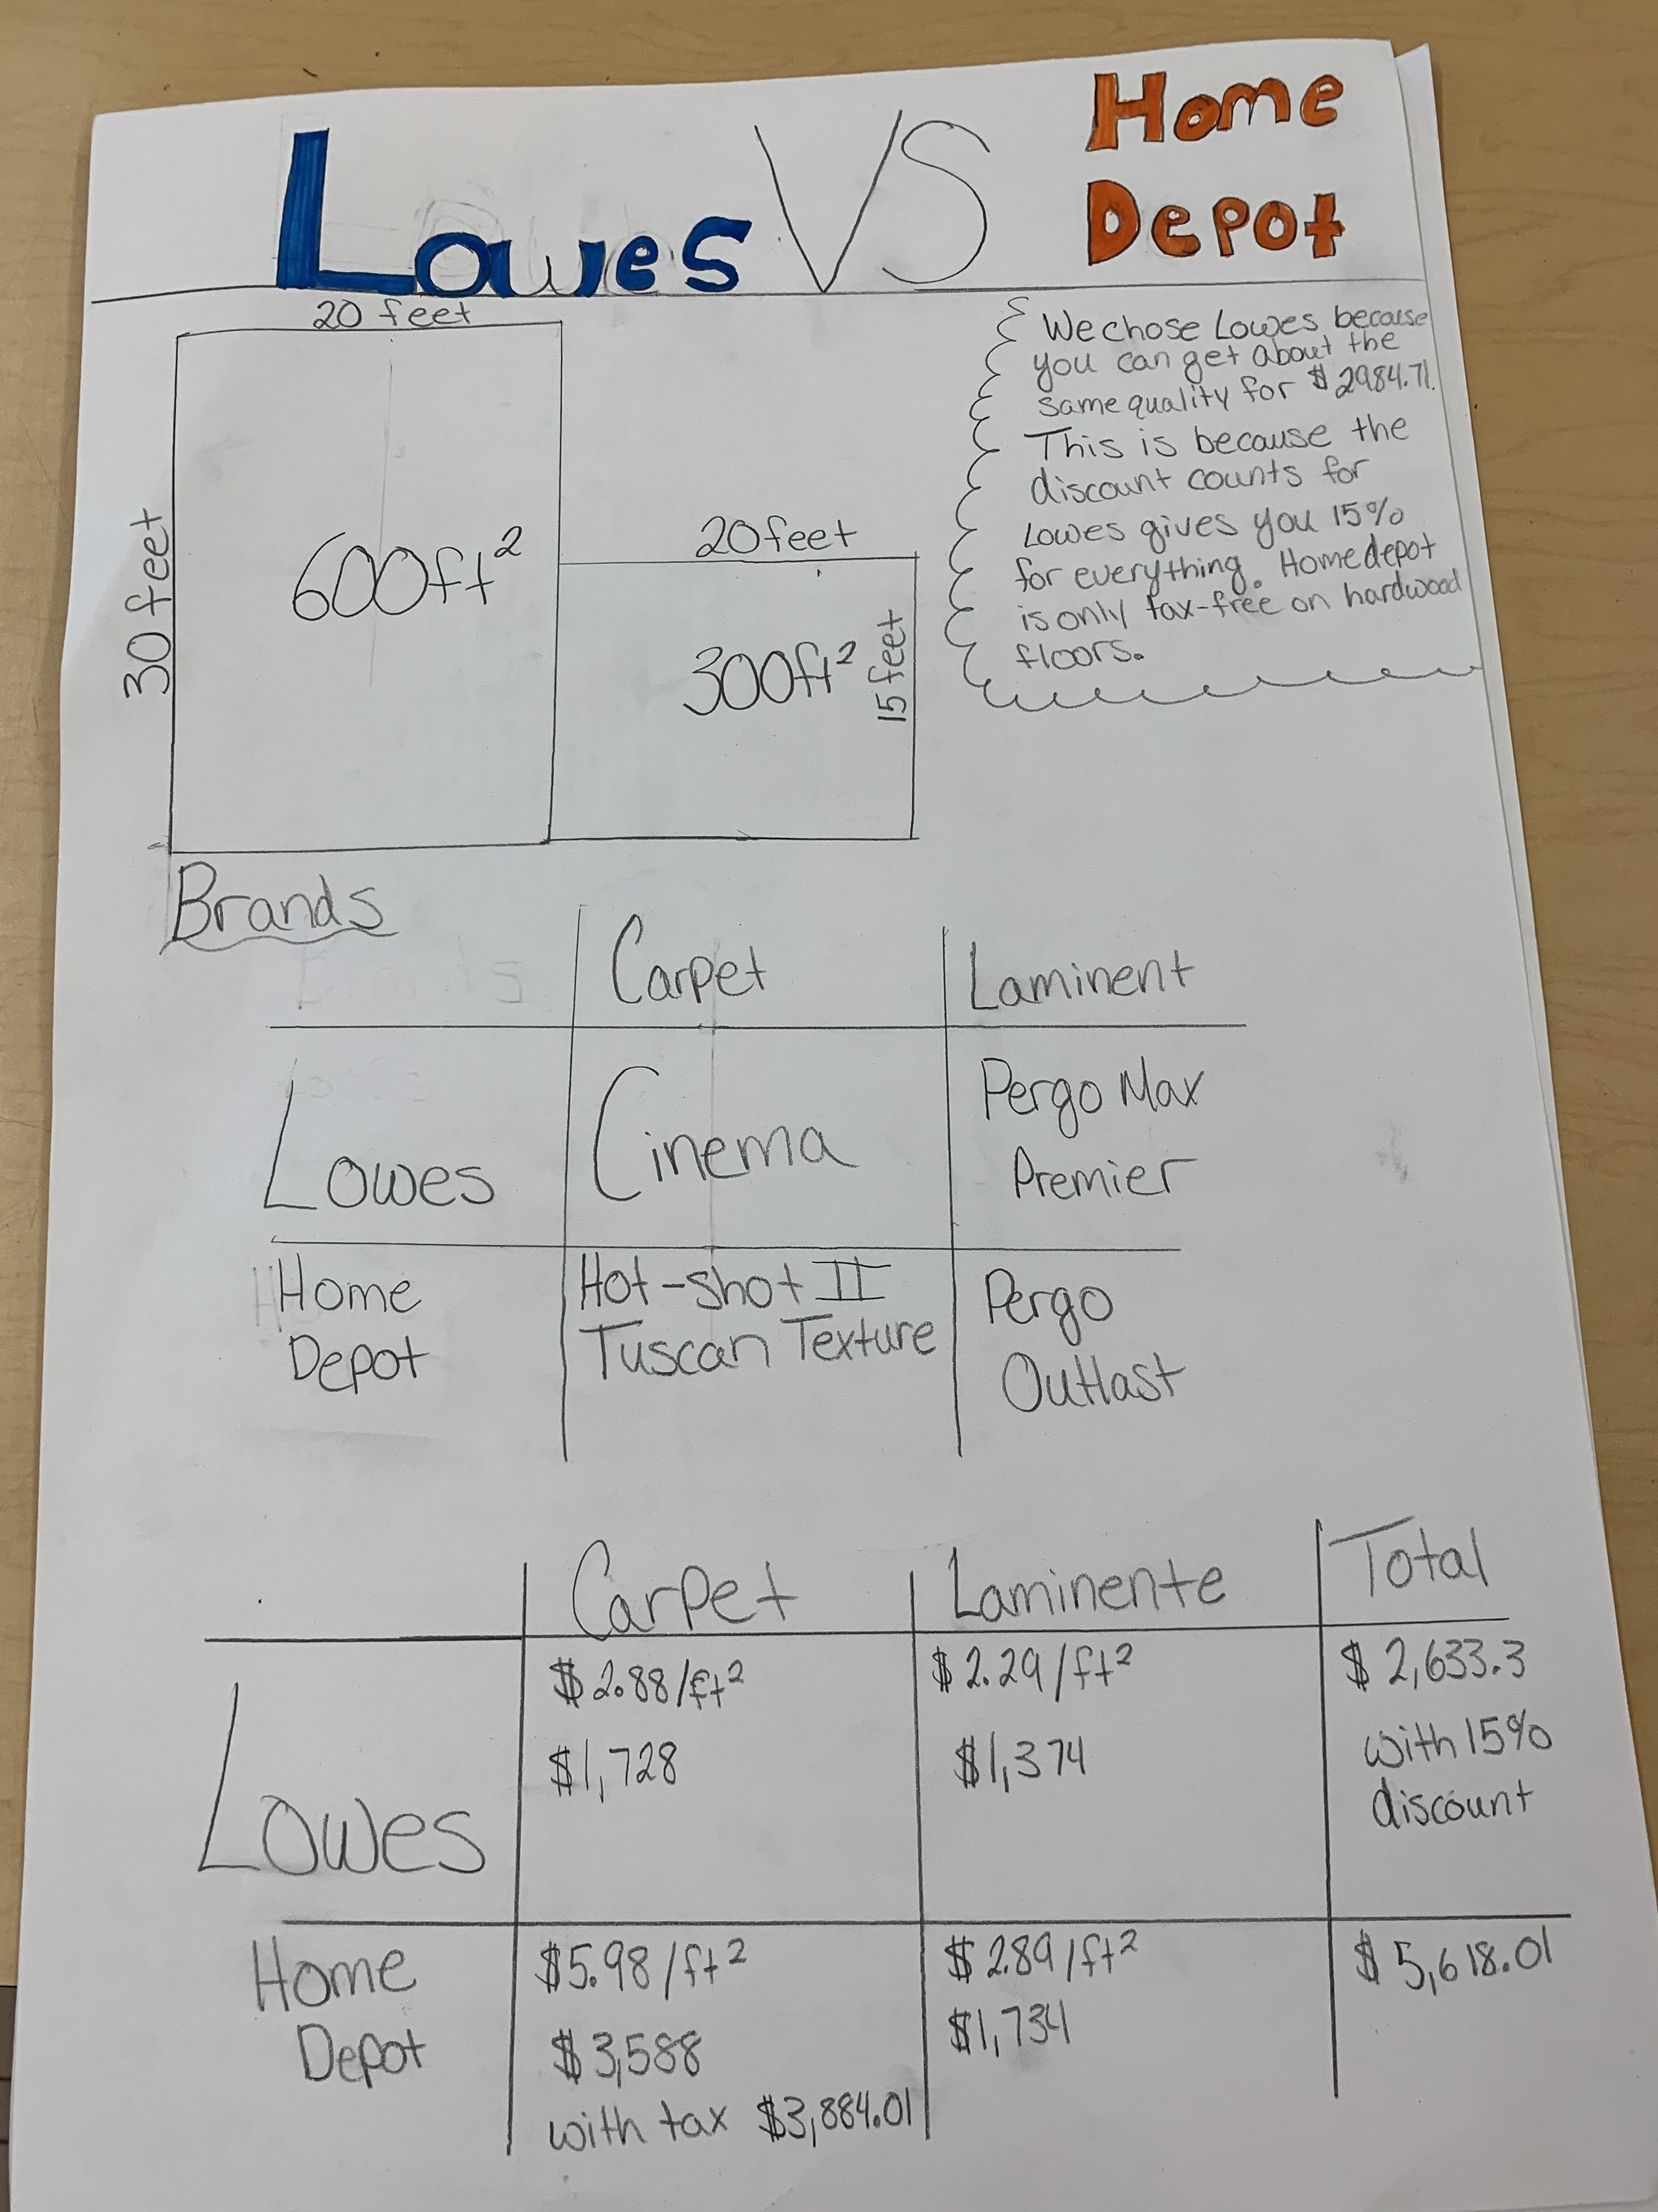
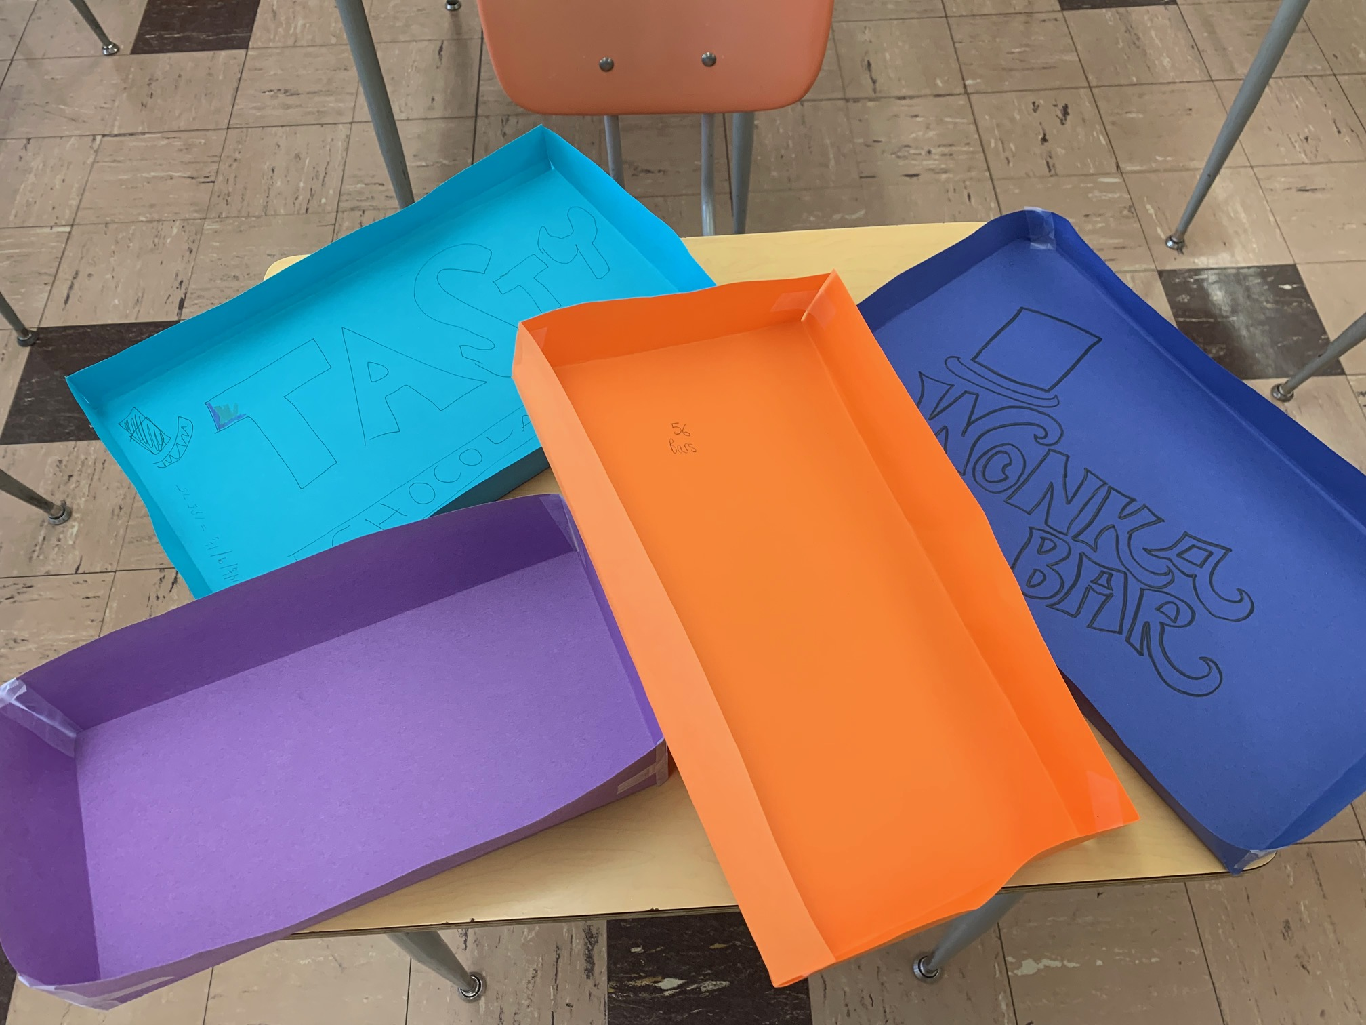
18-19 SY Pilot – Unit 3

Slide 26
18-19 SY Pilot – Units 4 & 5
The title of Unit 4 is Math in Decision Making. We will be starting this unit soon.
  Subsections included: Money, Safety, Logistics
  Summative task: Buying a House
The title of Unit 5 is Starting a Business.
  This unit will be the capstone project of the course and will take up the entire 4th quarter.
  Both of the pilot teachers are intrigued on how this unit will be executed.

