Slide 1
Why Pathway Work

Slide 2
Our Goal
“Our end goal is for students to know what they’re passionate about and learn all their skills through outside experiences to meet all our graduation competencies.”
Notes:
We want learning to be more than book knowledge, more than hypotheticals. We want learning to come from authentic, real world situations and experiences. This enables students to be more confident, more engaged, and more focused on a future. Our systems are set up for students who have a plan and a purpose. We want more students to enter college and career with that plan and purpose in hand.

Slide 3
PWR Act
For More Information...
Notes:
Passed 2016 in Illinois. Overall goal: to provide students with a means of gaining authentic experiences and motivation to transition successfully after HS graduation.

Slide 4
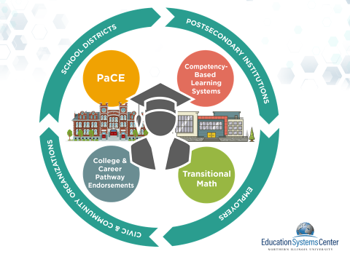

Slide 5
PaCE
For More Information…..

Slide 6
PaCE
Framework outlines what students should know about college and career each year from 8th to 12th grade. The framework must address, in an integrated way:
Career Exploration and Development
College Exploration, Preparation and Selection;
Financial Literacy and Accessing Financial Aid opportunities
Xello along with other products provide a means for helping districts to achieve the PaCE goals
Notes:
Plan developed by local school district to aid students in gaining experiences in career planning

Slide 7
Transitional Math
A CHOICE OF 3 PATHWAYS
For More Information...

Slide 8
Transitional ELA
For More Information…..

Slide 9
Competency-Based Learning
PILOT
For More Information...

Slide 10
College & Career Pathway Endorsements
EDUCATION, MANUFACTURING, AGRICULTURE
For More Information...

Slide 11
Components
Team-based challenges
Real–world problem
Industry-based mentor
Presentation component
2 challenges required
Career exploration activities
2 general or 1 intensive activity
60-Hour Supervised Experience
Internship in related field of endorsement
Credit or pay must be received
Professional skills assessed
Individualized Plan of Instruction
Resume, post-secondary alignment, financial literacy, personal statement
Ready for college credit in math and English
2 year minimum of focused coursework
6 hours of college credit
Updated annually
Gain one or more
Goal: Gaining field-based certificates, micro credentials or badges are highly recommended

Slide 12
CTE Education Pathway Grant
Notes:
Grant is allowing districts to build a system for embedding pathway work into their schools
Helping to “grow our own” teachers to alleviate the shortage

