Slide 1
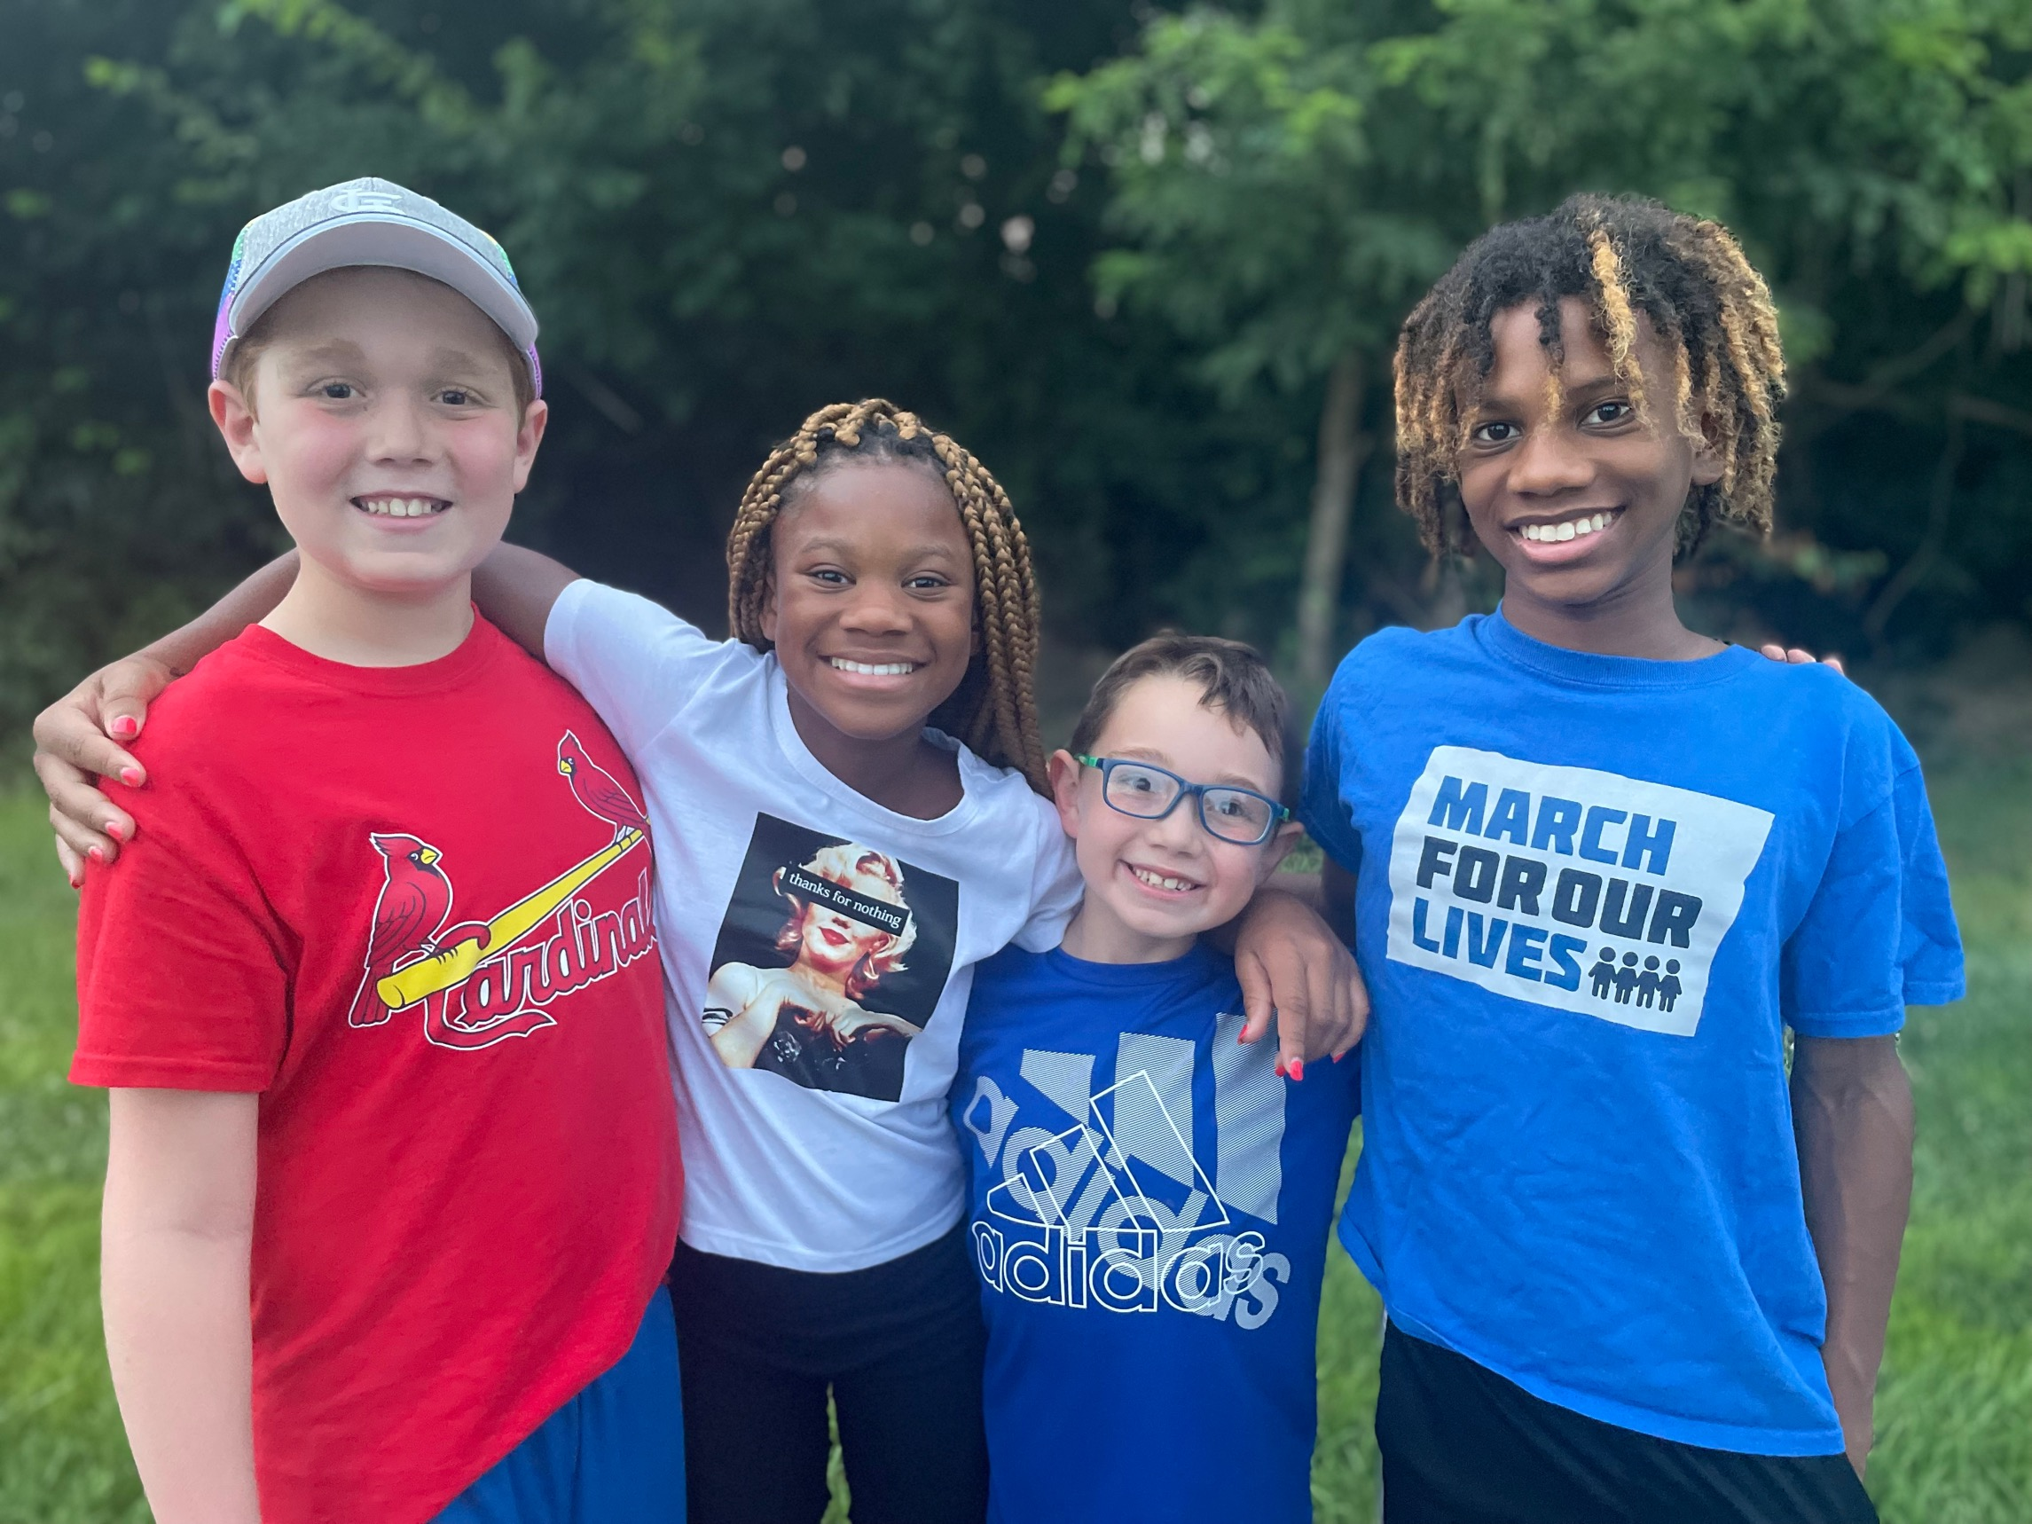
From Preparing for College and Careers to >> Equipping for Long and Livable Lives
Stephanie Malia Krauss
Tw. @stephanie_malia
IG. @wonder_and_wayfinding
www.stephaniemaliakrauss.com

Slide 2
Who are our students?

Slide 3
9/11 & The War On Terror
Early Childhood
COVID-19
Young Adults
Today’s
Graduates
2001
2007
2021
Start of Great Recession &
Smart Technologies
Kindergarten

Slide 4
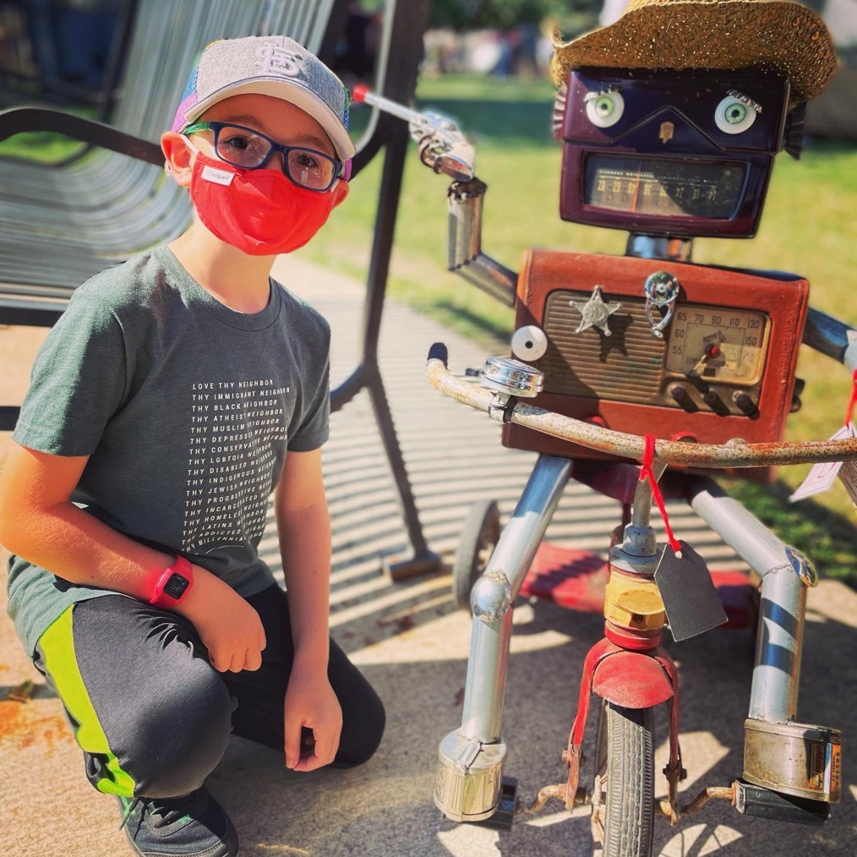
Today’s Kids
DIGITAL + DISRUPTION NATIVES
Tech Dependent
Used to Extremes
Kids only know life with smart technologies, social media, and online gaming.
Kids have only known a life of divides and disparities because of power, politics, pandemics, and more.
Survivors of Volatility & Violence
Digitally Divided
Kids are growing up in an age of mass shootings, racial violence, community violence, constant change, and other life-threatening problems.
There are huge differences in connectivity and device access.
Hyperconnected
Strong and Powerful
Kids seamlessly enter and exit virtual life.
They are dual citizens.
Kids are proximate to our most complex problems. They are poised to be our most powerful changemakers yet.

Slide 5
Differently Wired
Young people’s wiring is shaped and reshaped by environment and experience.
The biggest periods of developmental growth and transformation happen in
early childhood (0-5) and adolescence (~11-26).
Overwhelmed
Overloaded
1
2
Young people have access to information, 24/7. They are growing up in an “Open Source” society.
Young people and families are faced with too many demands and challenges. It can inhibit and delay executive functioning.
3
4
Unsafe and Unsettled
Young people have lived a lifetime of threats, stress, and volatility. They crave safety, security, and predictability.
Distracted
Distractions and notifications demand attention. Tech notifications trigger an addictive response stronger than a crack craving.
Big tech is designed for repeat use, not health.
5
Traumatized
The past two years have been collectively traumatizing. Young people most harmed are those already struggling with past and ongoing trauma, grief, and loss.

Slide 6
“Combine the stress and impact of global and national threats with the everyday stresses of life and you have a recipe for toxic stress, trauma, grief, and loss.
This is hardest for young people who are marginalized because of their histories, identities, and life circumstances.
For these young people, they experience compounded toxicity because of the constant reminders and messages that say they are bad, damaged, different, or don’t belong.”
Making It, p. 14

Slide 7
What will tomorrow’s
world be like?

Slide 8
Three Forces Changing Everything
“To succeed, young people will need to become innovators and disruptors, builders and rebuilders, caregivers and creators.”
Machines
Technologies, including robots, augmented reality, virtual reality, and artificial intelligence.
Momentum
The rate of change. Acceleration, innovation, and global competition.
Markets
How we produce and consume. From knowledge economy to learning economy.
Making It, 22-23

Slide 9
College & Career Ready can be an outdated and flawed roadmap.
High School
College
Career
Retirement

Slide 10
Realistic Readiness Roadmap
Today’s young people need to prepare for the possibility of a 60- or 70-year working life.
This includes multiple jobs, career paths, and periods of under- or unemployment.
Job Loss
Period of not working, for any number of reasons
Back to School
Learn & Earn
Upskilling, reskilling, or career shifting.
First experiences with postsecondary education and/or employment.
New Job(s)
Job(s)
Longer lives means working longer. This roadmap is one that keeps going.
Working full-time. Could be multiple jobs or just one.

Slide 11
Preparing Students for the Future of Work
From Ready for Jobs to Ready for the Journey
Durable Work
Livable Work
Equip students with knowledge and skills that are difficult to outsource or automate.
Ensure students are ready for jobs that provide the work, wages, and wellness conditions they need.
Lovable Work
Transferable Work
Times are tough. Students should be able to do work they enjoy, and that they’re good at.
The market is rapidly changing. Students should be equipped with knowledge and skills that can transfer to new jobs.

Slide 12
What are the four currencies kids need to be ready for this future?

Slide 13
Competencies
Ways of being and doing in the world
1
Focus & Get Things Done
Solve Problems &
Make Decisions
4
The ability to concentrate and tune in, even amidst distractions.
The ability to figure out what’s going on and then do what needs
to be done
2
Think, Create, Apply
Get & Stay Fit
5
The ability to navigate, learn, experience, and contribute.
The ability to stay physically, emotionally, and cognitively healthy.
3
Respond, Regulate, Persist
Relate & Engage
6
In times of change and challenge, this is the ability to persist, maintain hope, and grow.
The ability to experience, form, nurture, and sustain healthy relationships.

Slide 14
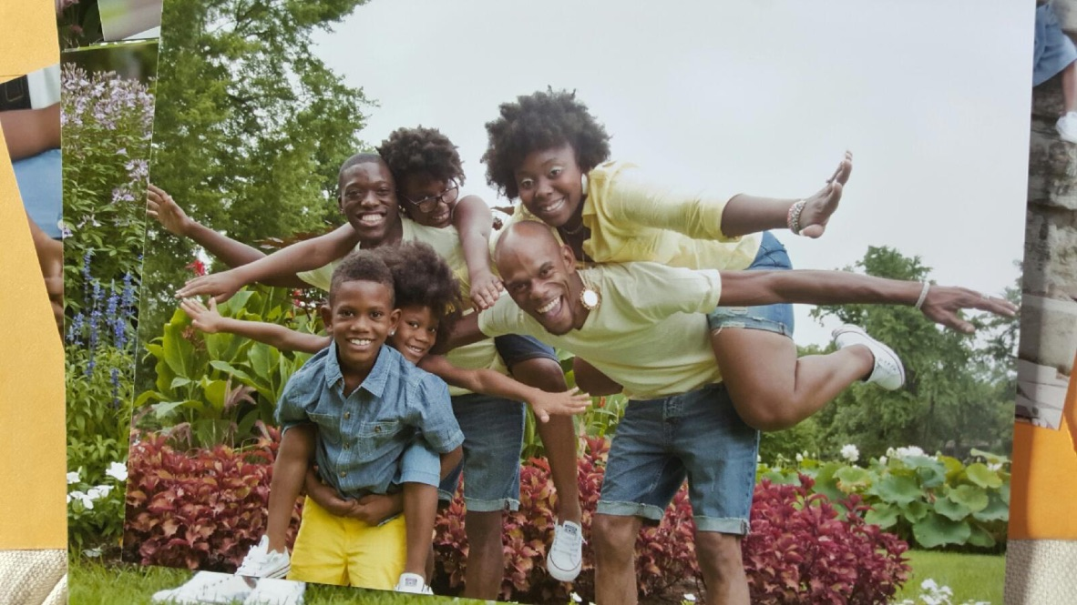
Connections
Who we know and who knows us.
This determines a child’s social health and social wealth.
1
Lifelines
People who have your back, no matter what.
2
Navigators
People who help you figure out where to go and what to do.
3
Door Openers
People who build or offer bridges to new opportunities and options.
4
Social Capital
Connections may be the most powerful currency of all.

Slide 15
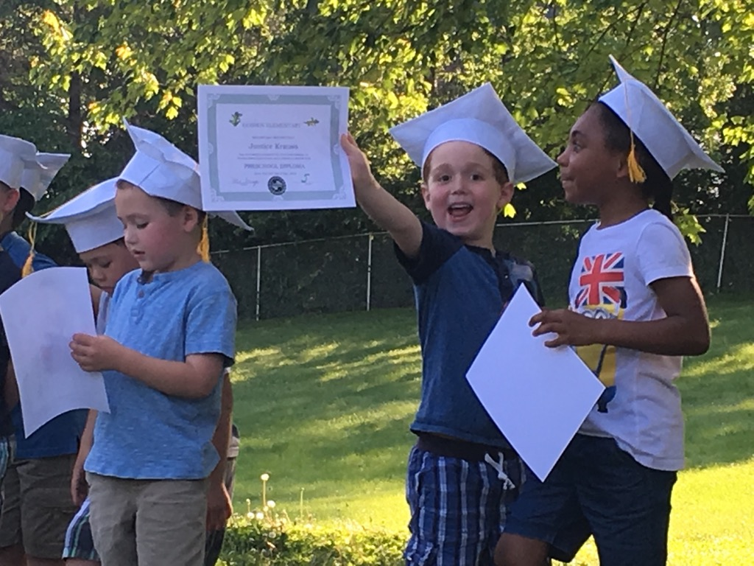
Credentials
In the US, more than half of jobs require a postsecondary credential. Diplomas, degrees, and certificates are critical, but can be crushing in cost.
1
Kids Are Consumers
There are more than 600,000 different types of postsecondary credentials in the US.
2
Crucial for Work and Wages
Often used to sort candidates and as a poor proxy for being qualified, a credential will position kids for better work and wages.
3
“Now, Next” Principle
Instead of deciding what to do for a lifetime, we can help young people shrink their time horizon and focus on what problem to solve, issue to dig into, causes to commit to, and jobs to do for the next 3-5 years.

Slide 16
Cash
Today’s kids are being raised in recessions and economic crises.
Many households are cash-stretched and financially-stressed.
Learning and life are expensive. Cash matters.
1
Poverty
3
Glass Ceilings
Being poor saps kids’ mental energy. The focus is pulled to getting by. Immediate needs make it hard to look ahead, learn, and work.
The “glass floor” for some is a glass ceiling for others. America is a place of opportunity being out of reach for many.
2
Scarcity
4
Smoothing Out
Cash scarcity happens at every income level. Children of color experience compounded and collective scarcity that is more harmful than what their white peers experience.
We must prepare kids for
financial spikes, dips, and emergencies.

Slide 17
What does this mean for
educators and schools?

Slide 18
We Must Become Currency Builders
Today’s kids could live a 100-year life. That means a 60-70 working life.
Everything depends on what happens in the first quarter.
Build Currencies Anytime & Anywhere
Take a Whole Child, Whole Life Approach
Deepen partnerships with families, parents, and the broader learning ecosystem.
Context matters. Consider the vertical and horizontal of children’s lives.
Be Just, Inclusive & Caring
Listen to and learn from young people. Create spaces where kids see themselves, and know they belong.
Make Currencies a
Part of Everything.
Blend and braid currency-building into children’s everyday environments and experiences.
Be an Advocate & Ally
Be an agent of change. Remove barriers, shift power, change policies and structures. Create ways for kids and families to be their own best advocates.

Slide 19
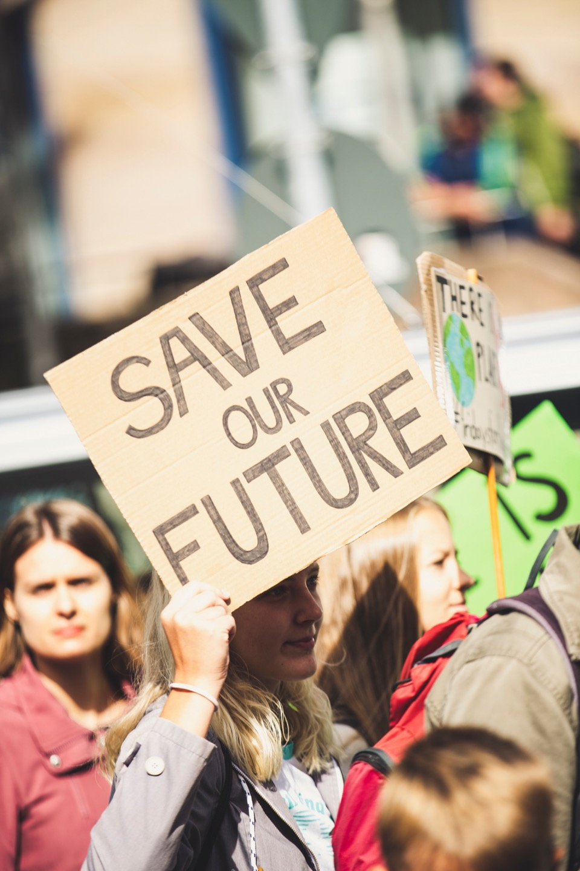
“We start by helping today’s kids acquire the currencies they need. As we do that, we must find other currency-builders and work collectively to change the world, systems and structures they are growing up in, finally making them fair and just. Currency-builders see this dual-role as a moral imperative.”
Making It, 145

Slide 20
Let’s Talk!
@stephanie_malia

Slide 21
Implementation
Ideas
What does this mean our school(s) and district?
What does this mean for me and my work?
Where can I start doing and stop doing?
What would it take for us to be a community of currency-builders?
“This work continues even when the future feels unpredictable. During these times, it is critical that we get a handle on what is happening, so that we can anticipate the full range of young people’s possible futures and figure out what those possibilities require. The stakes are high, and lives are on the line. We cannot afford to operate from outdated notions of what readiness used to require.”
- Making It, p. 131

